Slide 1
Valley Campus Main Building
Addition & Renovation
Alamosa, Colorado
PROGRAM PLAN
Prepared for:
TRINIDAD STATE COLLEGE

Slide 2
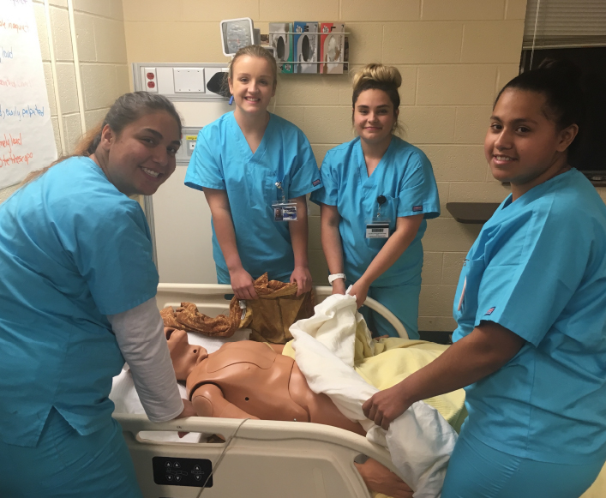
Trinidad State College:
SLV Campus, Alamosa
Serve 500 – 600 students each semester
Signature programs:
  Nursing (CNA to BSN)
  Medical Assisting, Dental Assisting
  EMS, Paramedic
  Law Enforcement Academy
  Teacher Prep (Early Childhood, Elementary)
  Welding, Construction Trades, Automotive
  Adult Basic Ed and GED
Train the majority of healthcare workers, law enforcement officers, and first responders in the Valley.
#3 Nursing program in the state by NCLEX pass rates.

Slide 3
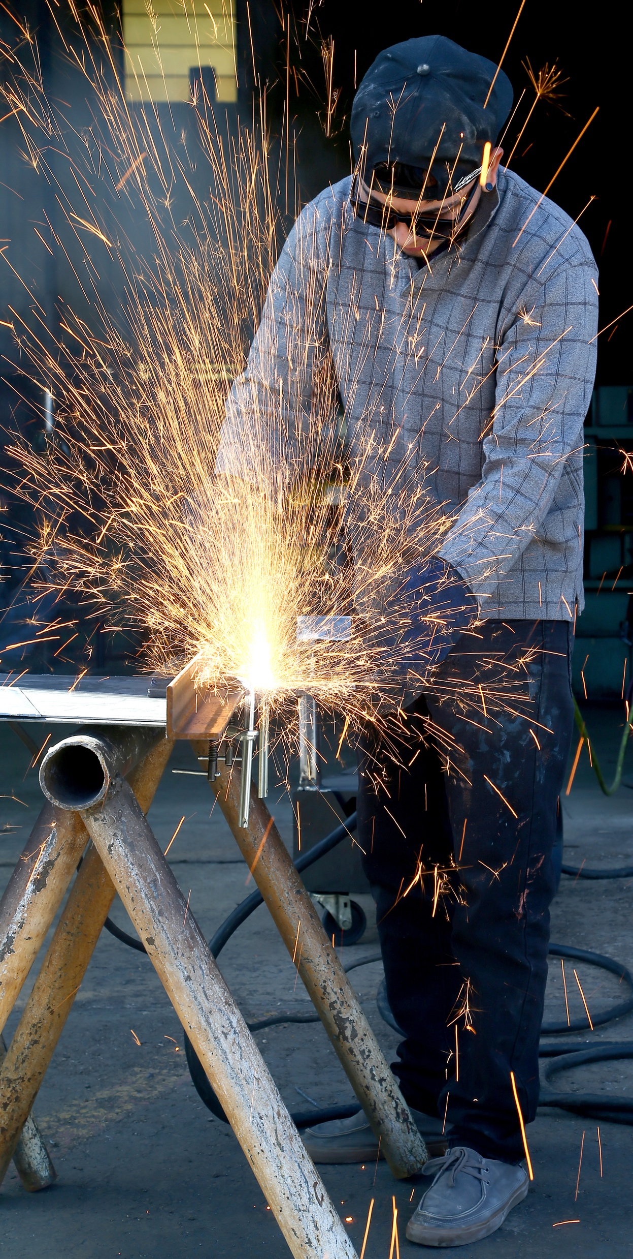
Trinidad State College:
Valley Campus, Alamosa
Main building – 1936 (originally an elementary school)
  Vocational trades bays added in 1998
  Addition of 2 science lab/classrooms added in 2015
Allied Health building – 1965 (previously mental health clinic)
  Purchased in 2002 by TSC Foundation
  Poor condition
  Slated for demolition in Facilities Master Plan

Slide 4

Major issues to be addressed in project
Condition and performance of HVAC systems/equipment
Age of roofing
Non-accessible restrooms and elevators
Age and condition of main electrical service
Interior finishes
Single pane windows
Poor efficiency of lighting and controls
Lack of fire sprinkler system in majority of building
Lack of clear building entrance/security concerns
Lack of study space or student gathering spaces
Poor condition of Allied Health building overall
  inadequate to support learning

Slide 5
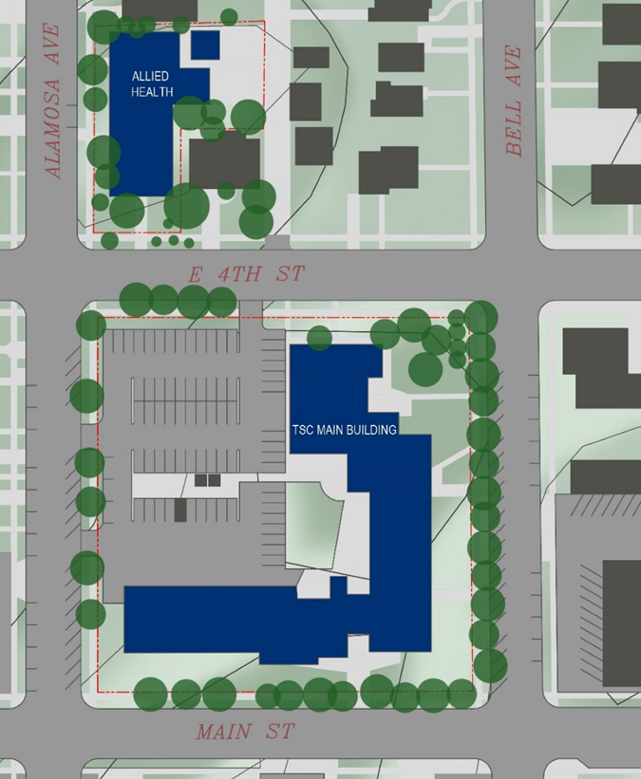
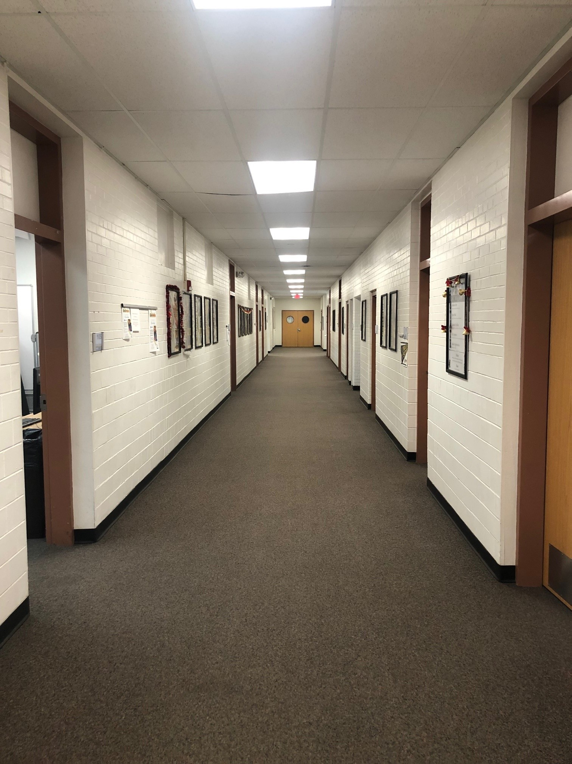
Proposed
New Addition
Main building – “Elementary School” floorplan
No main entrance, reception, or lobby – poor
wayfinding to student services.

Slide 6
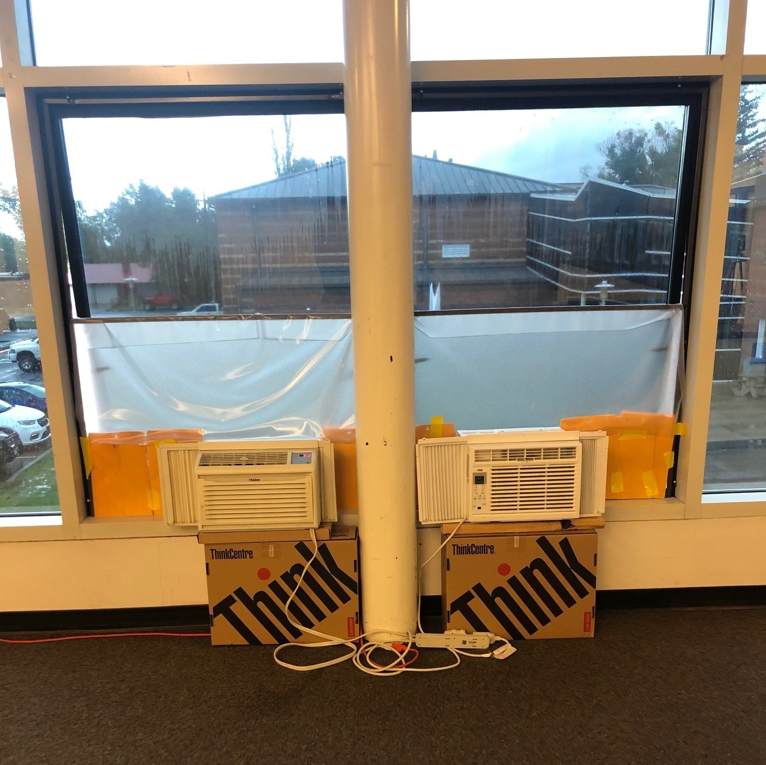
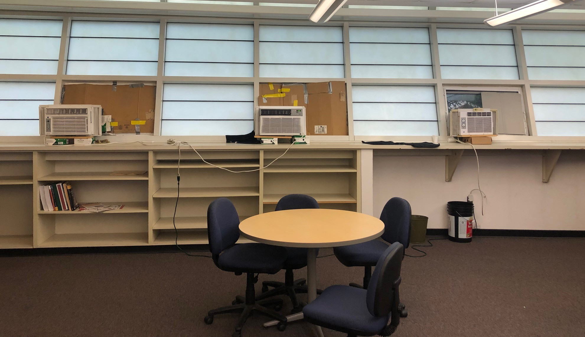
Indoor Climate Control: Temperature
fluctuates from 55 degrees in winter
to 105 degrees in summer.

Slide 7
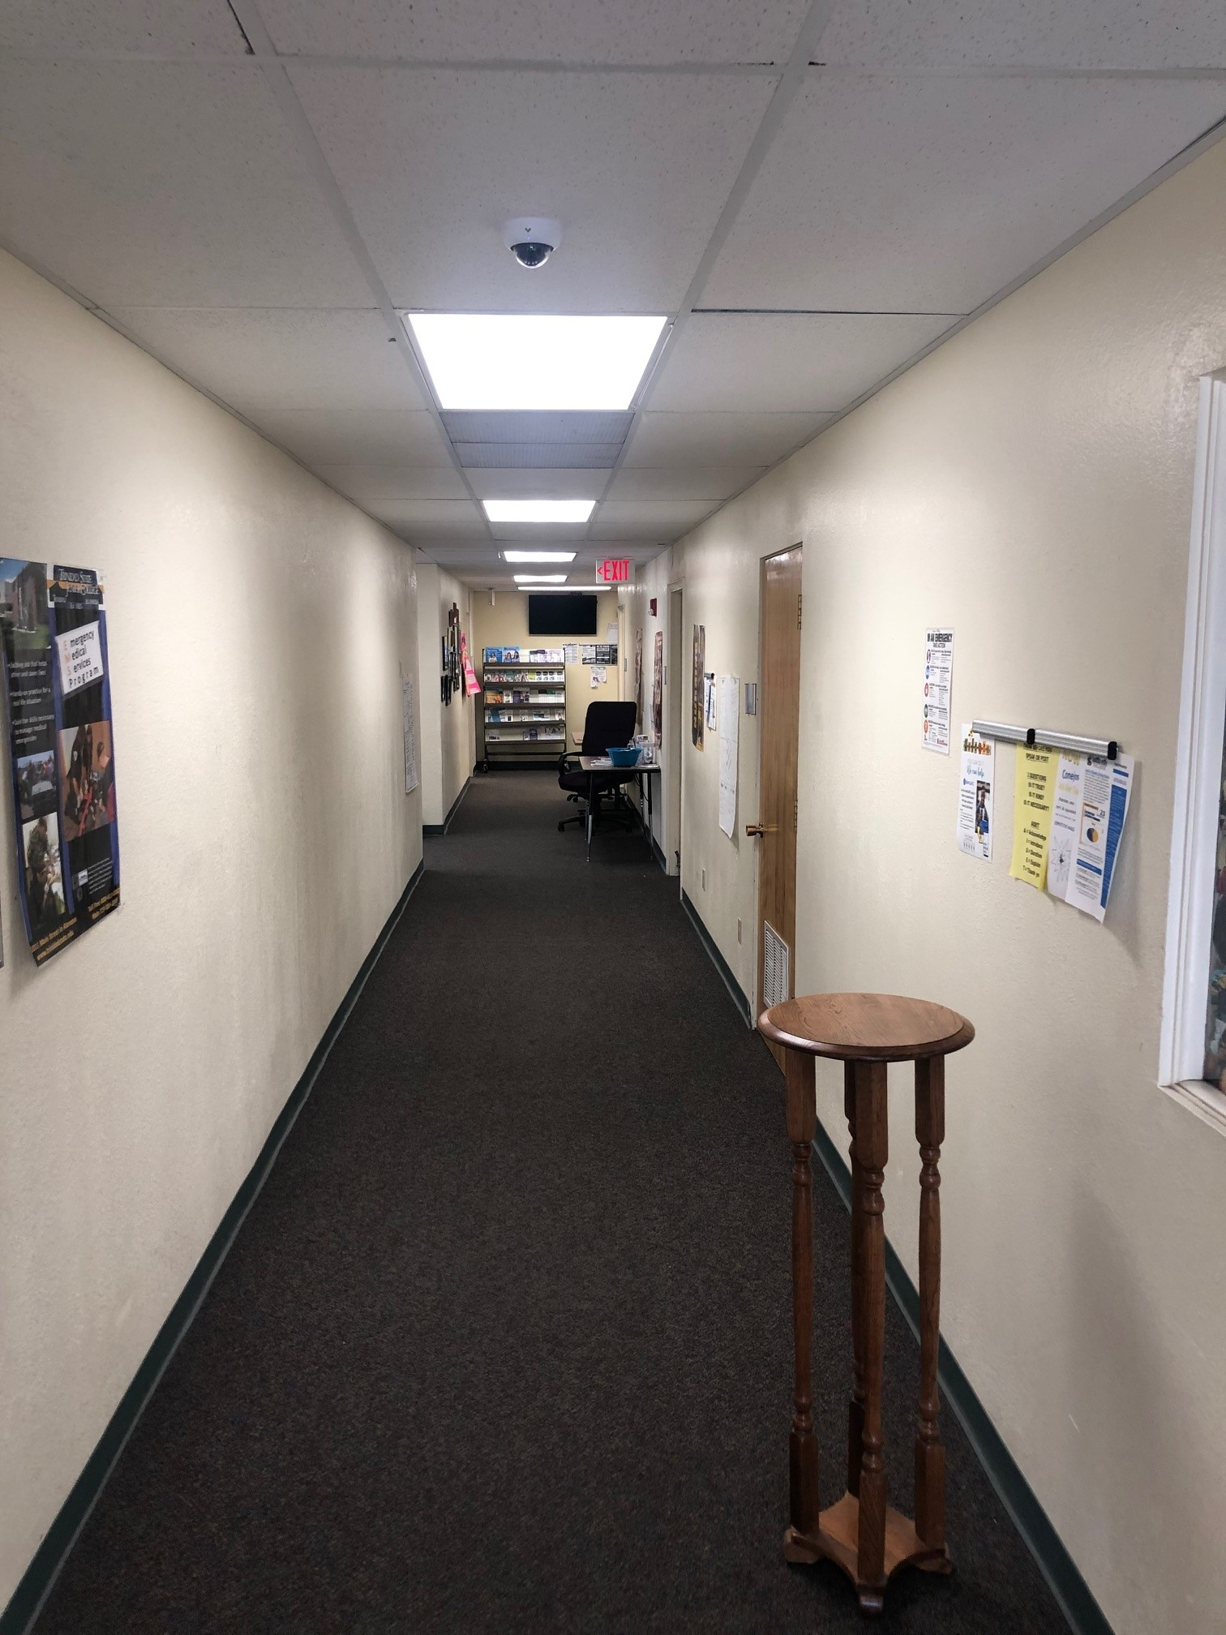
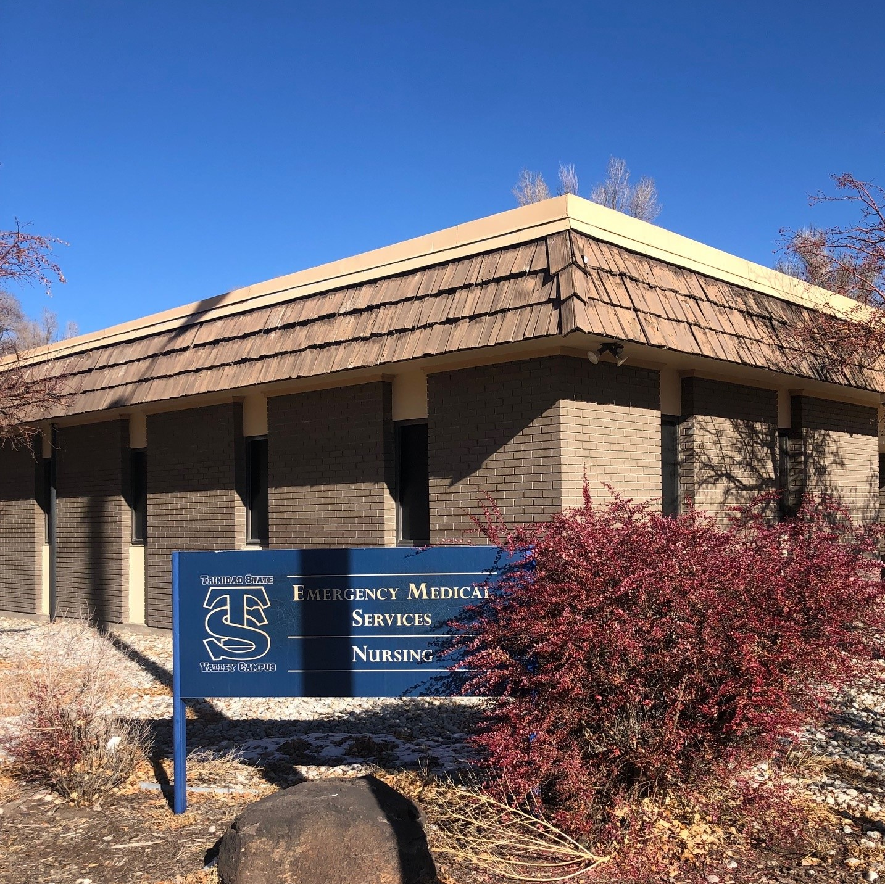
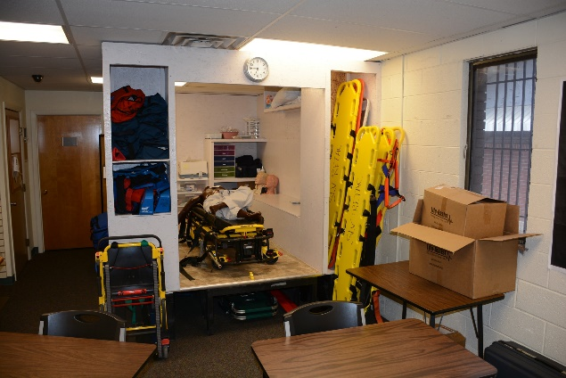

Allied Health Building
Poorly performing HVAC
Failing flat metal roof
Inefficient single pane windows
Raised wood floor – low bearing
capacity (not commercial grade)
Low ceilings
Aging plumbing, failing septic

Slide 8
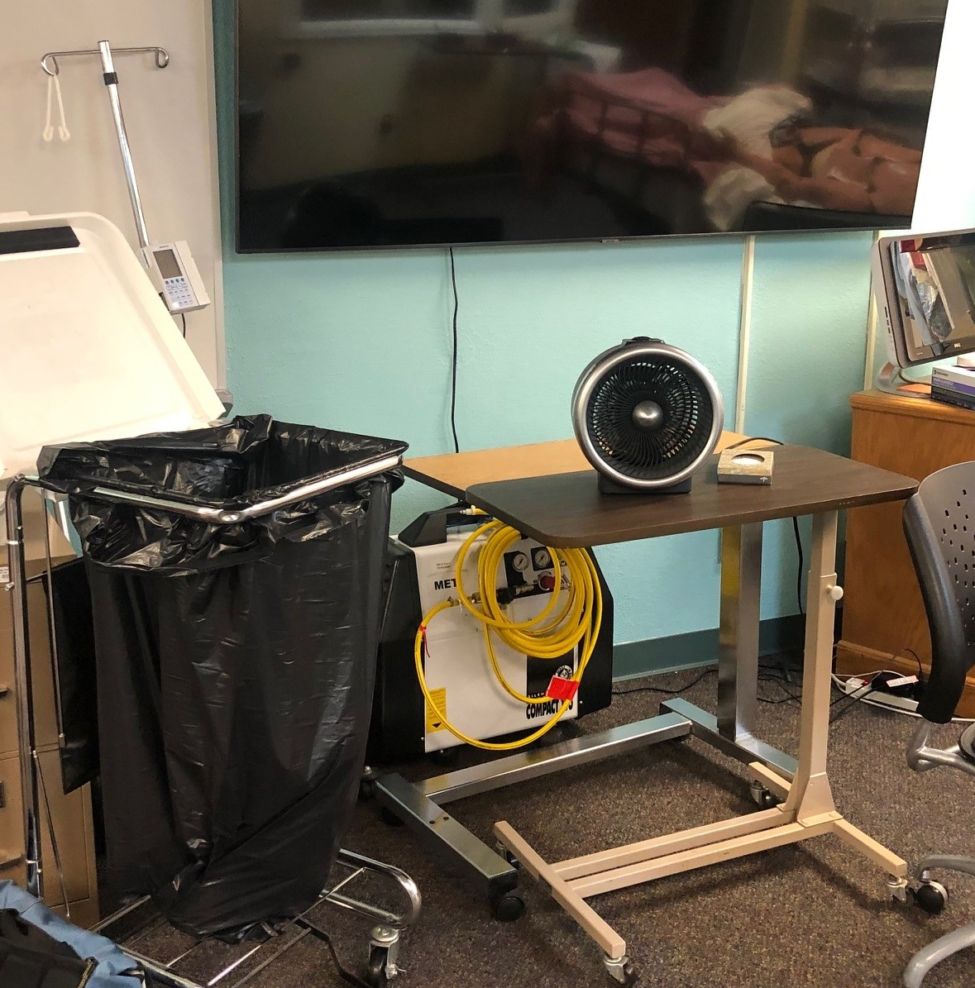
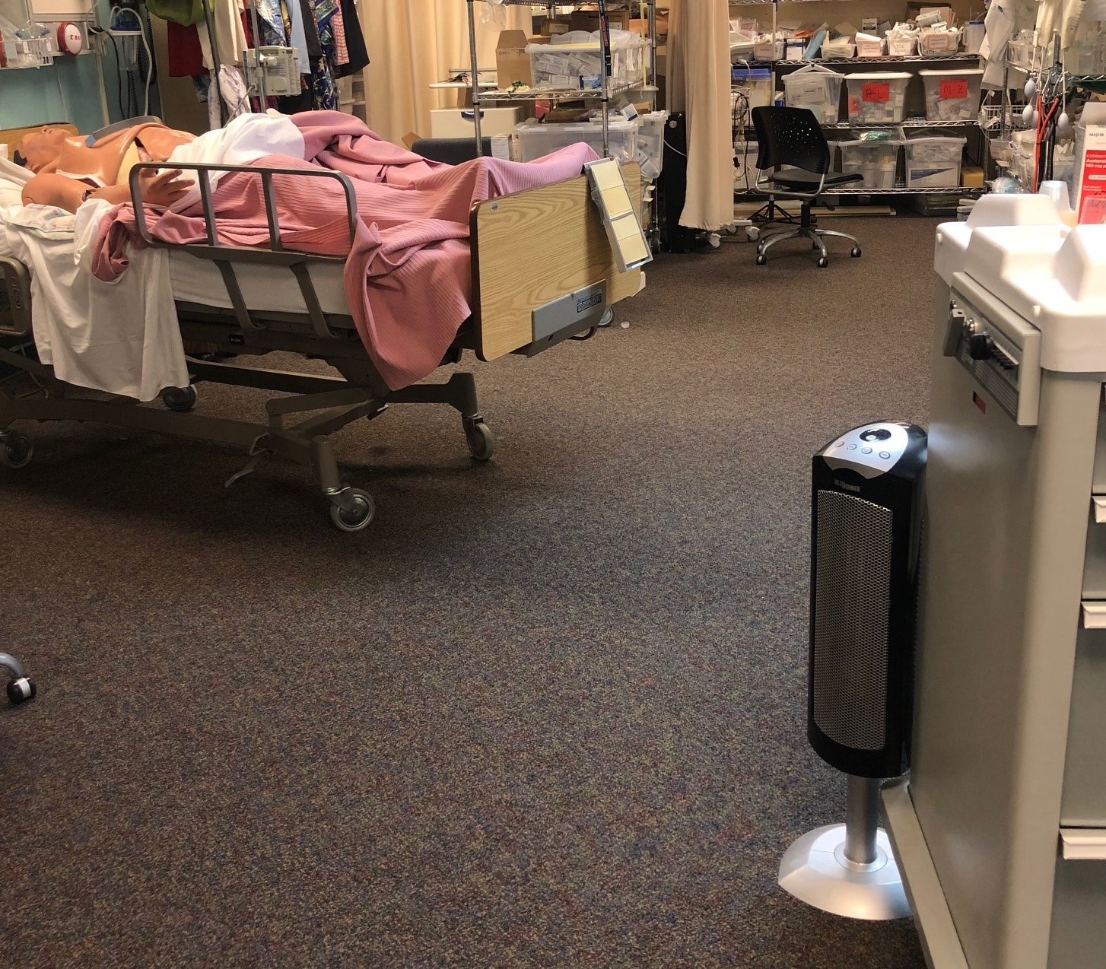
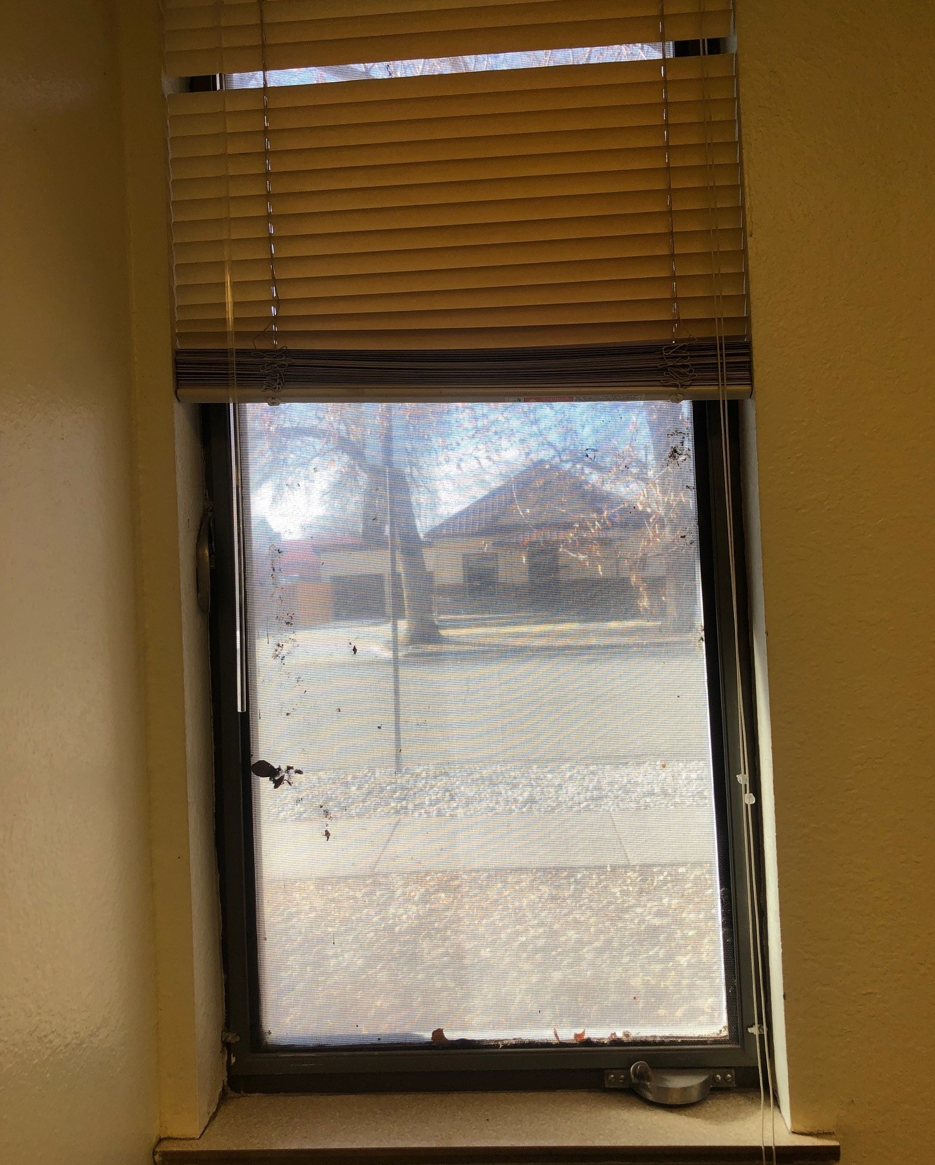
Allied Health Building
Use of space heaters
Single pane windows drafty

Slide 9
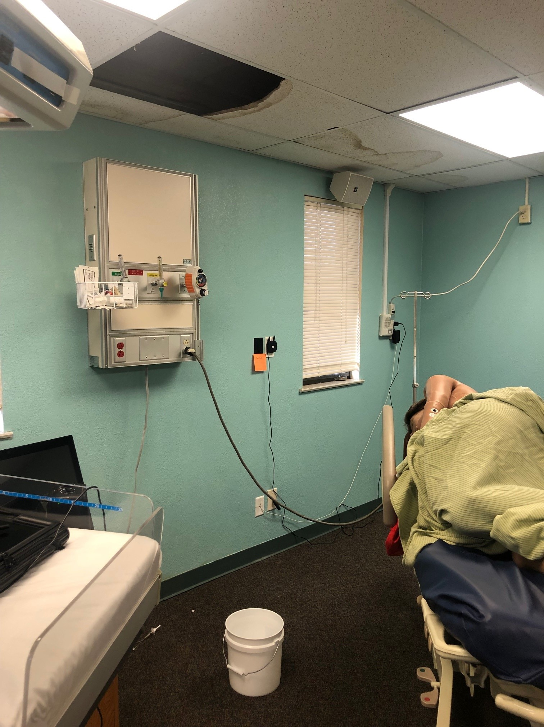
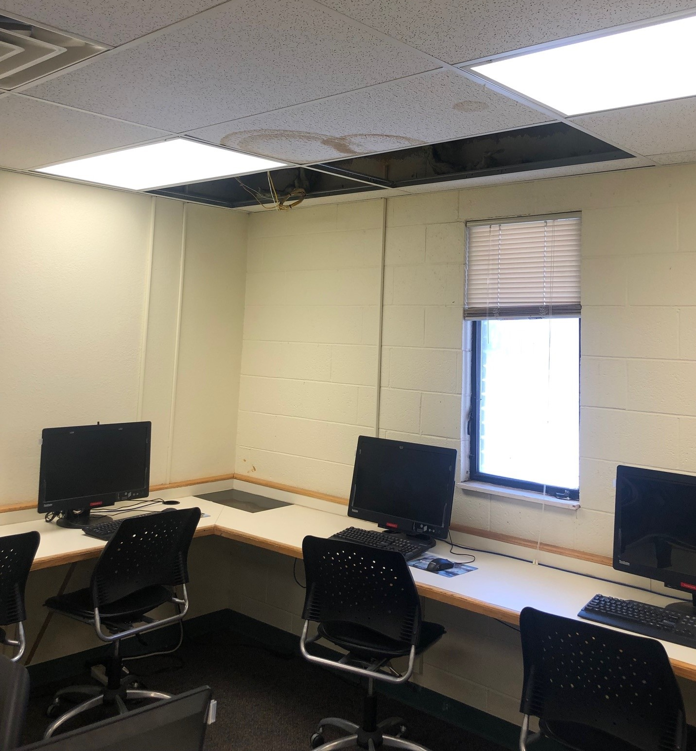
Allied Health Building
Roof leaks above computers and simulation mannequins

Slide 10
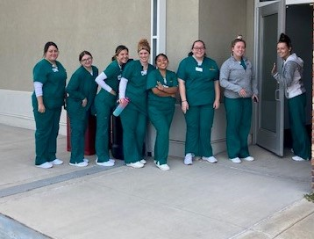
Allied Health Building
Students standing in line for
restroom at Main Bldg when
plumbing backs up in Allied
Health building.

Slide 11
Project Summary
Main Building Addition and Renovation
Two-story addition to create a One-Stop Student Services area and main building entrance.
Allows Allied Health Programs to move into main building and expand programs for in-demand careers.
  Nursing expands from 30 to 50 students/yr
  EMS expands from 20 to 32 students/yr
  Medical Assisting expands from 26 to 42 students/yr
Total Project Costs:
  Phase I - $6,337,816
  Phase II - $13,056,248

Slide 12
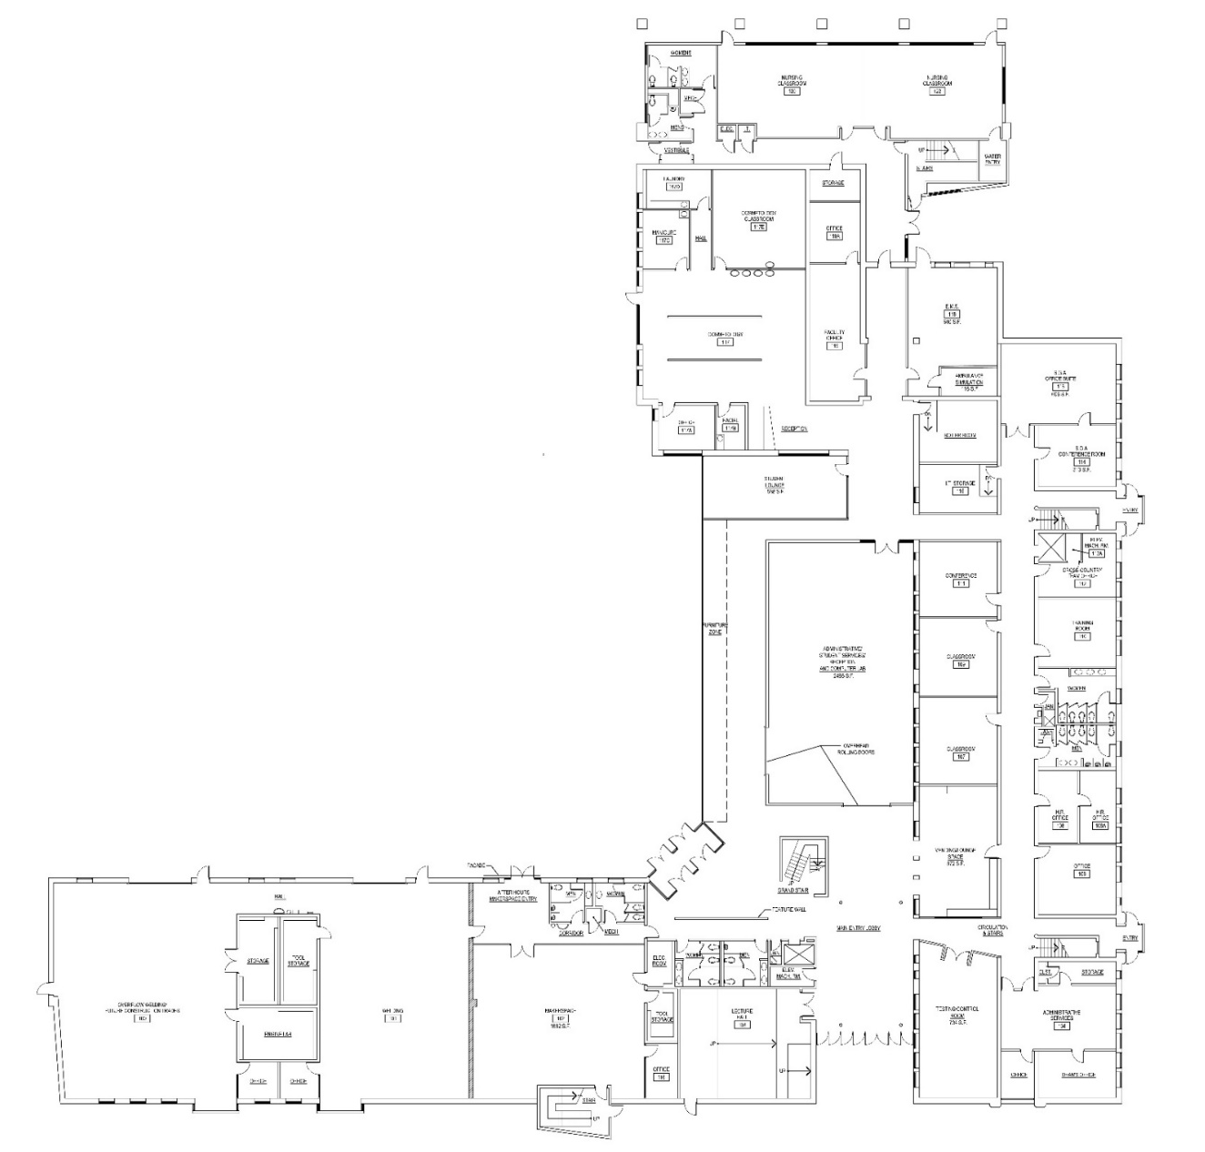

Main Building Addition
One-Stop Student Services, Offices, Assembly
Allied Health Relocation
Nursing Classrooms, EMS Lab
First Floor
Nursing
Classrooms
assigned to
existing flex
classrooms
EMS Lab
with Ambulance
Simulation
New 640 ASF Study Lounge with glass walls
One-Stop
Student Services
New Main Building Entrance

Slide 13
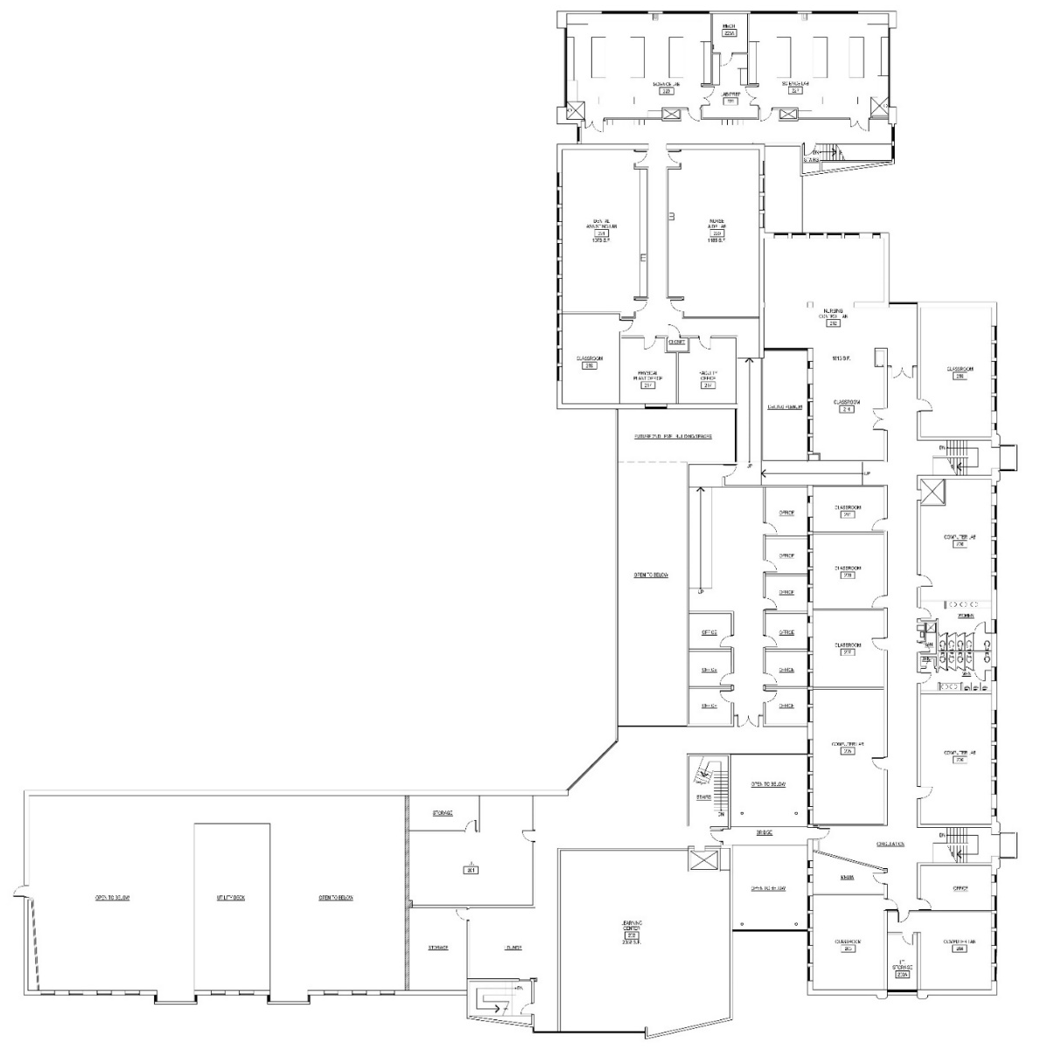
Allied Health Relocation
Dental Assisting, Nurse Aide, Nursing Sim Labs - Second Floor
New Nurse
Aide Lab 1,185 ASF
New Dental
Assisting Lab
1,073 ASF
New Nursing
Sim Lab and
Control Room
1,813 ASF
Area assigned to
Future Nursing Lab
Area purposed for new
office suite

