Slide 1
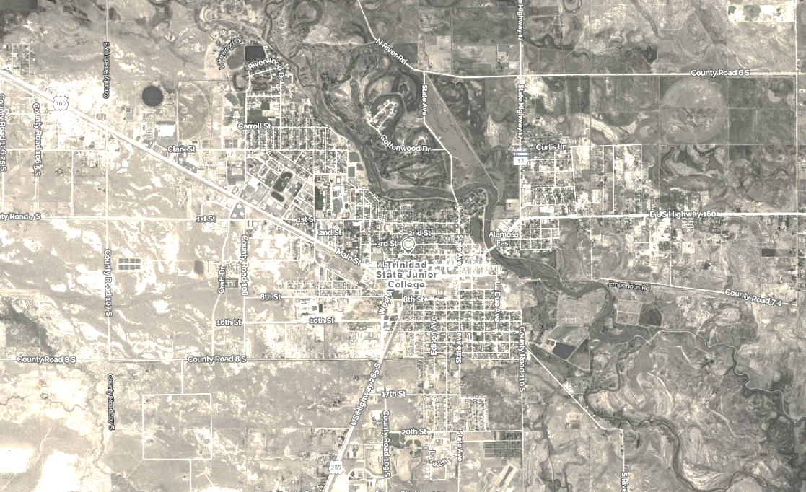
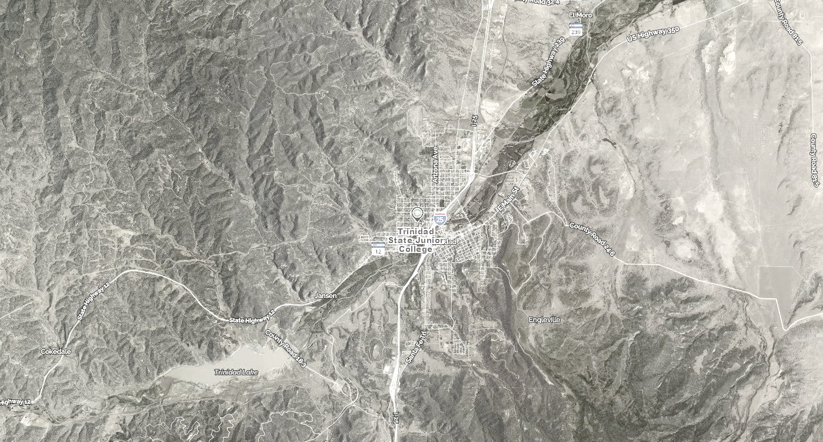
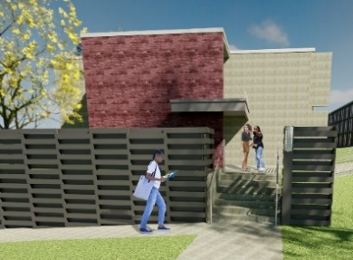
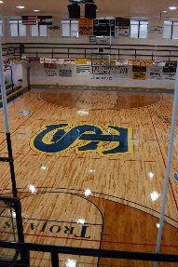
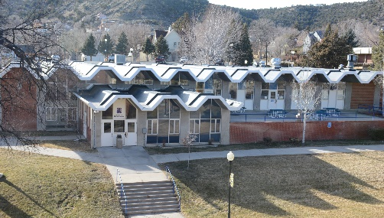
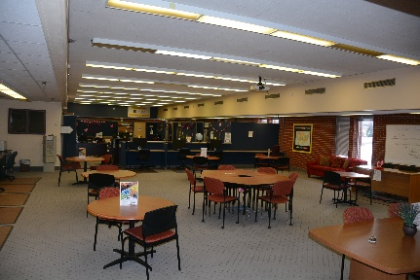
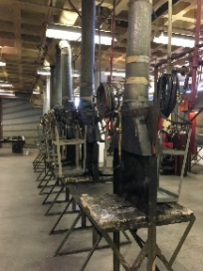
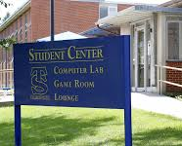
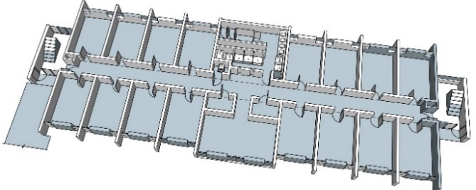
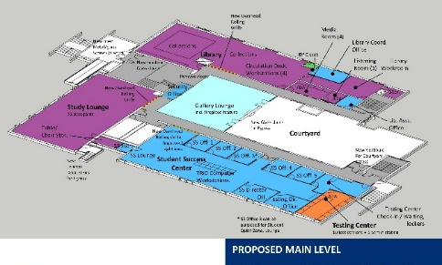
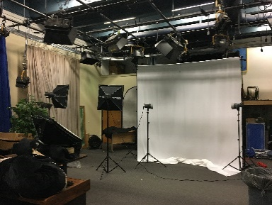
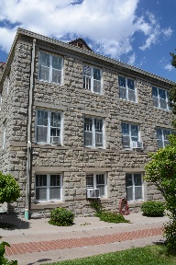
Valley
Campus
Trinidad
Campus
FACILITIES MASTER PLAN – TRINIDAD CAMPUS
Community Meeting December 6, 2021
Offices
Resident Life
Teaching Laboratories
Recreation & Athletics
Assembly & Exhibit
Learning Resource Center
Classrooms
Informal Learning Space
Student Center
Other Department Space
Physical Plant

Slide 2
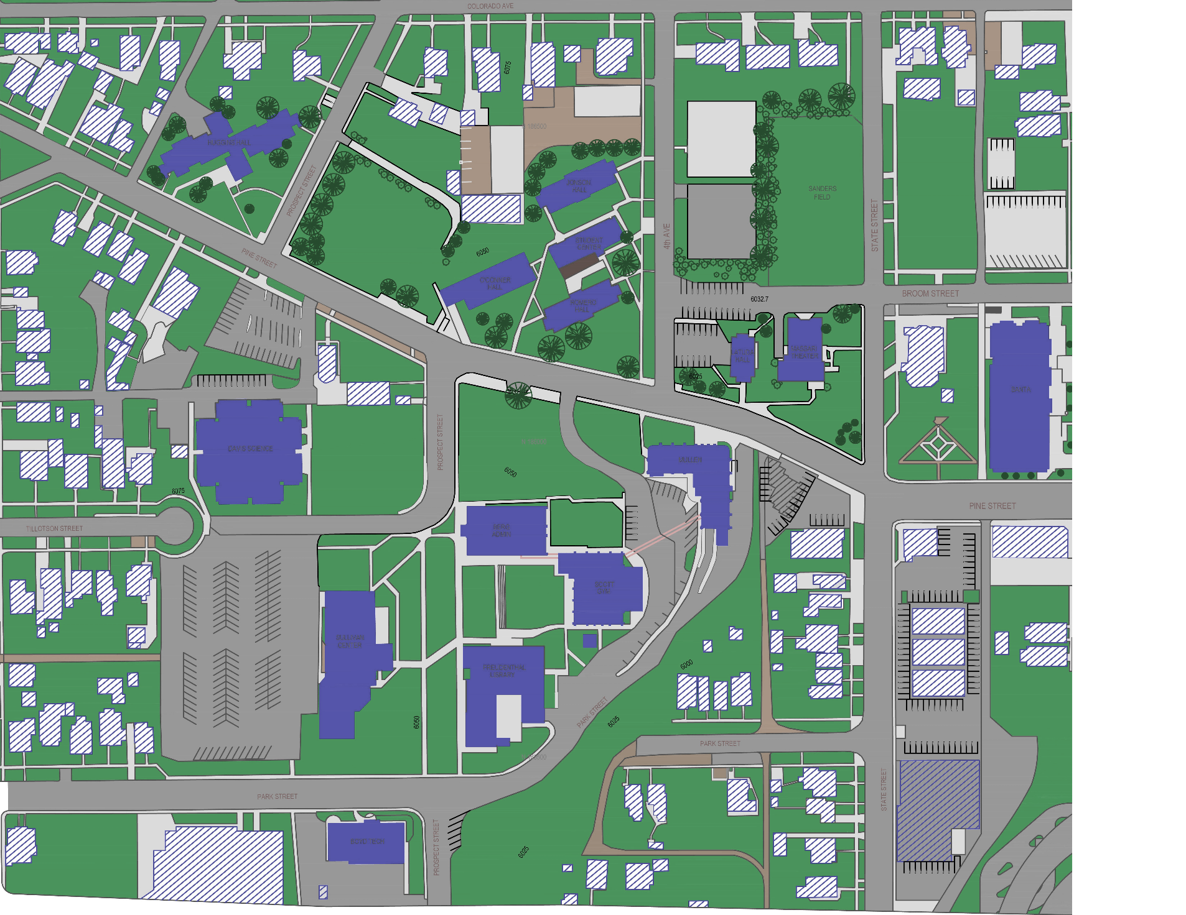
FMP TSC Committee Members
FMP Team
Dr. Rhonda Epper
Lynette Bates
Kerry Gabrielson
James Kynor
Shannon Shiveley
Al Malespini /
Danny Rogers
Ira Williamson
Michael Salbato
Toni DeAngelis
Jay Jacobson
Hall Architects:
Angeline Aradanas-Hall
Stephen Hall
Nov ‘20
May ‘18
SmithGroup:
Steve Schonberger
FMP Collaboration

Slide 3
Review: The FMP and The Process
A. Purpose of the Facilities Master Plan:
Provides Trinidad State College a comprehensive, active “living” document
to guide the planning of campus facilities
Driven by the TSC Mission, Vision and Values statements and
aligns with TSC Strategic Plan – 2020-2025 Centennial Goals, Academic Plan,
IT Master Plan and physical goals
Flexible and responsive
Participatory
Phased and implementable - manages development opportunities
Main Goal: Facilities Master Plan Ten Year Horizon - 2032
How do we accomplish this goal?
Partnership of TSC community + Hall Architects / SmithGroup
B. The FMP has four parts: (1) Process + Overview
(2) Program Information + Institutional Data
(3) Existing Conditions Assessment
(4) The Plan

Slide 4
FMP + Facility Audit Schedule
Continue meetings, prepare FMP Final Draft for TSC Leadership Team review, confirm FMP projects, refine Draft
Project Kickoff
Participant scheduling, initial data collection: identify academic programs, staffing, resident programs
Confirm enrollment, priority of FMP projects, review data analysis, continue meetings
Final deliverables to TSC for presentation to the State
Two campus sites: Conduct meetings, interviews, prepare surveys, facility inventory data collection, initiate analyses
Nov ‘20
May ‘18
Feb ‘21
July ‘21
Jan ‘22
Dec ‘20
Dec ‘21
Facility Audit documentation
Prepare Facility Audit draft

Slide 5
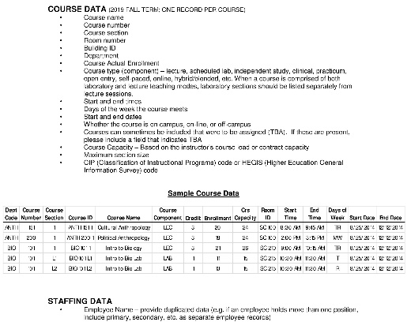
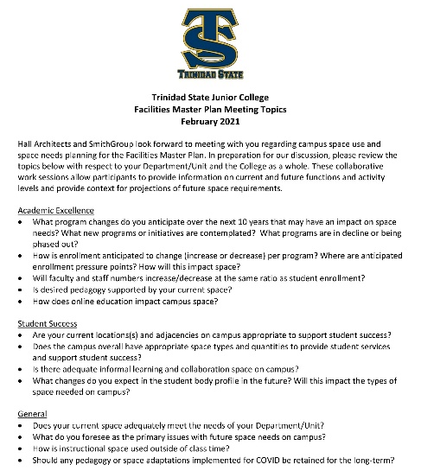
Baseline Data Collection – Fall 2019
Space Needs Analysis
Base Year: Campus Total Surplus of 36,600 ASF
Target Year 2032: Campus Total Surplus of 3,897 ASF
TSC Interviews
35+ Interviews
Should any pedagogy of space adaptations implemented for COVID be retained for the long term?
TSC Stakeholder Interviews – partial list
City of Trinidad, CDOT, Corazon de Trinidad,
Trinidad School District #1, SCCOG, DOLA
Facilities Inventories / Facilties Audits
15 Major Buildings on the Trinidad Campus, 319,334 GSF
67% of buildings are between age 50 – 74 years
27% of buildings are over 75 years
Student, Faculty, Staff Surveys
Data Collection

Slide 6
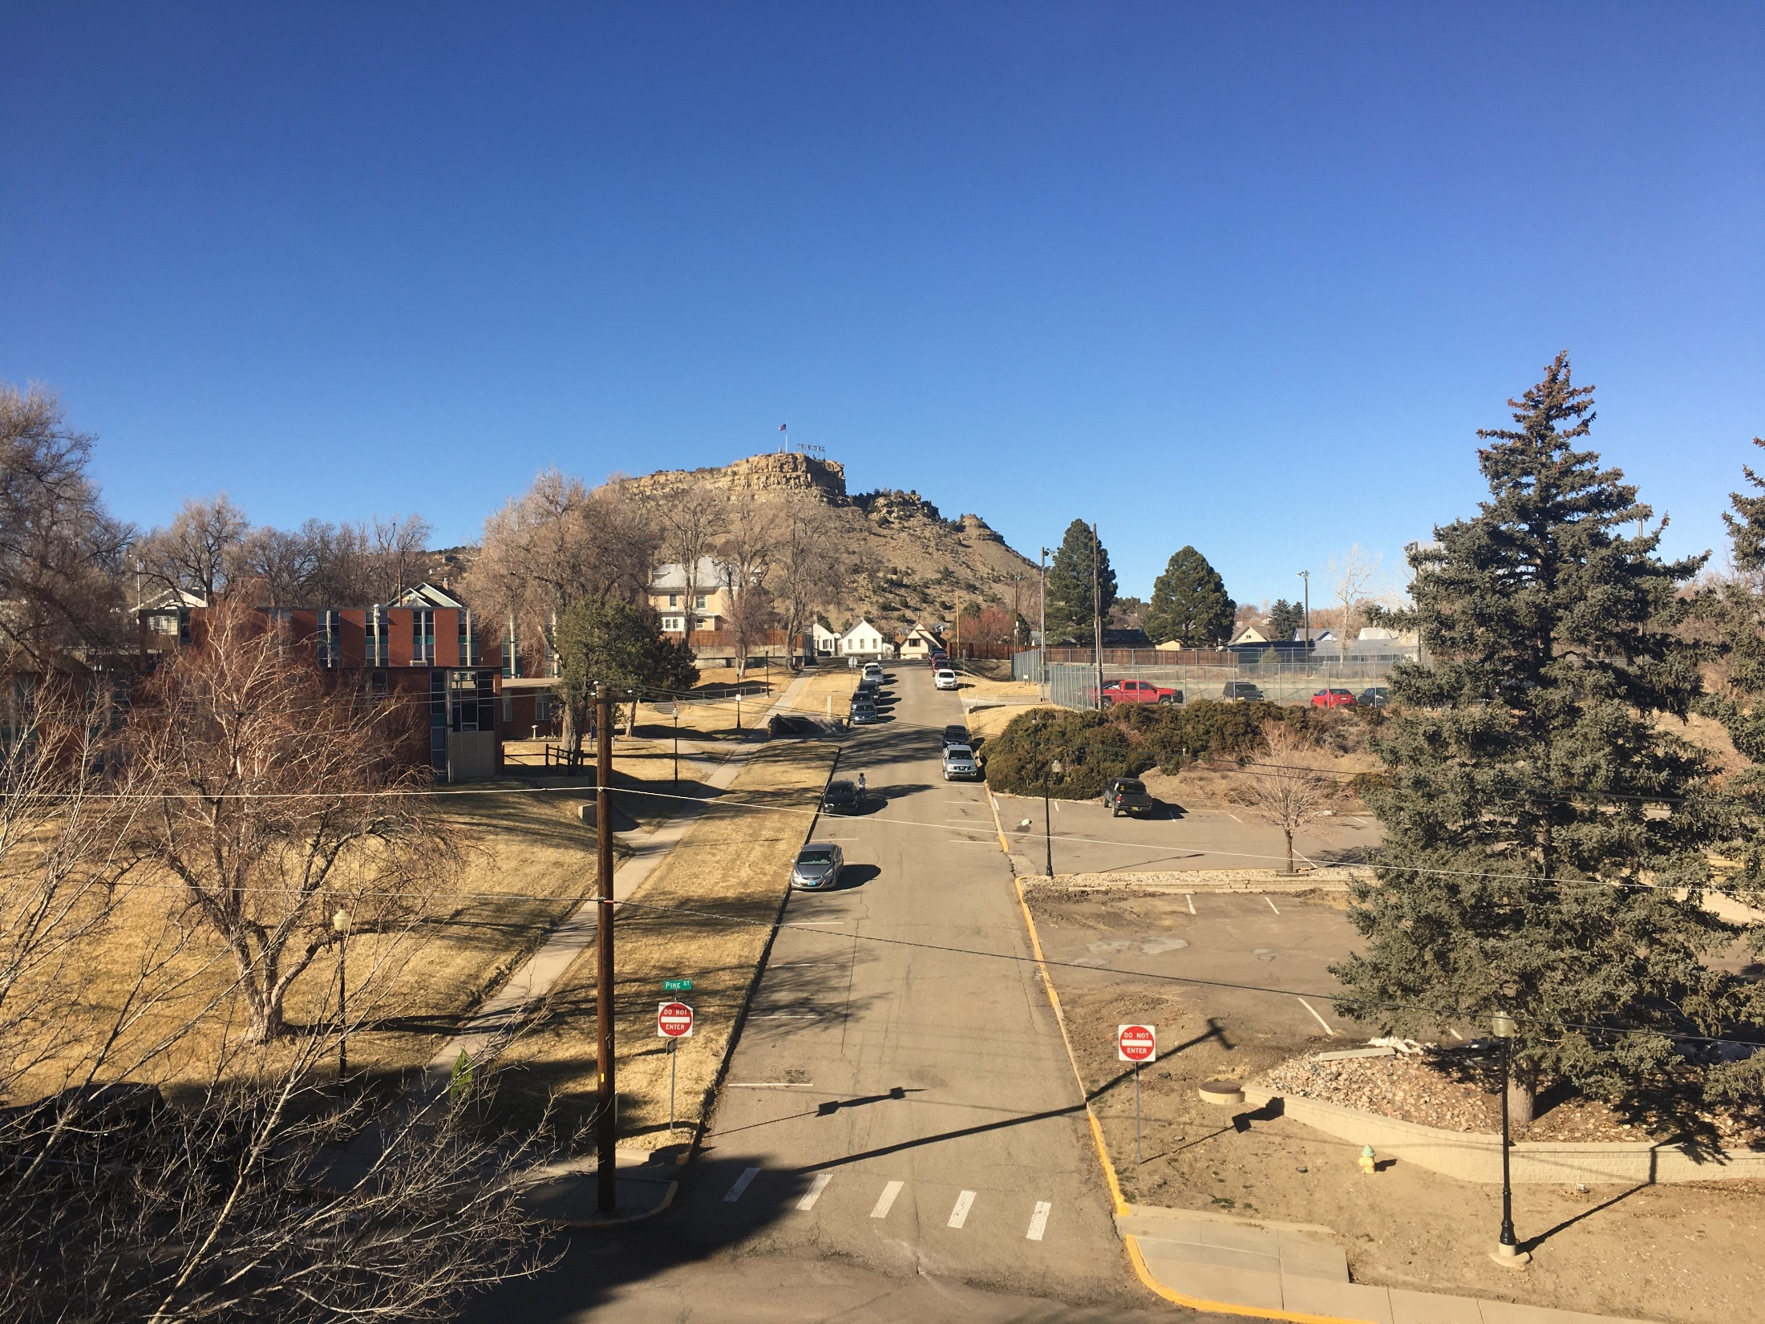
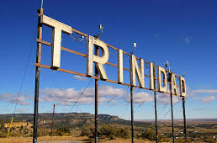
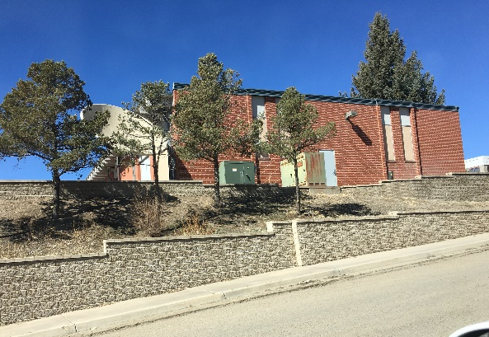
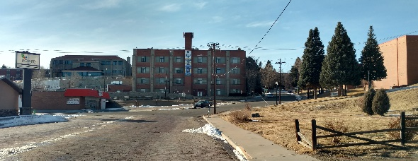
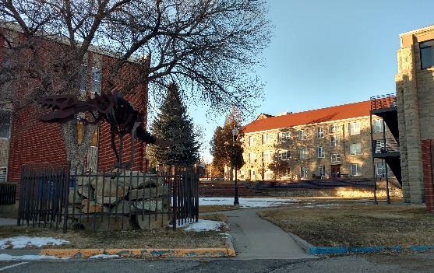
Uniqueness of Place: Trinidad Campus, Trinidad
*
* Photo credit: TripAdvisor

Slide 7
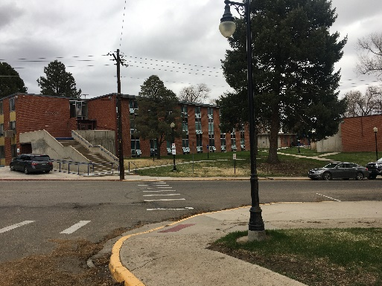
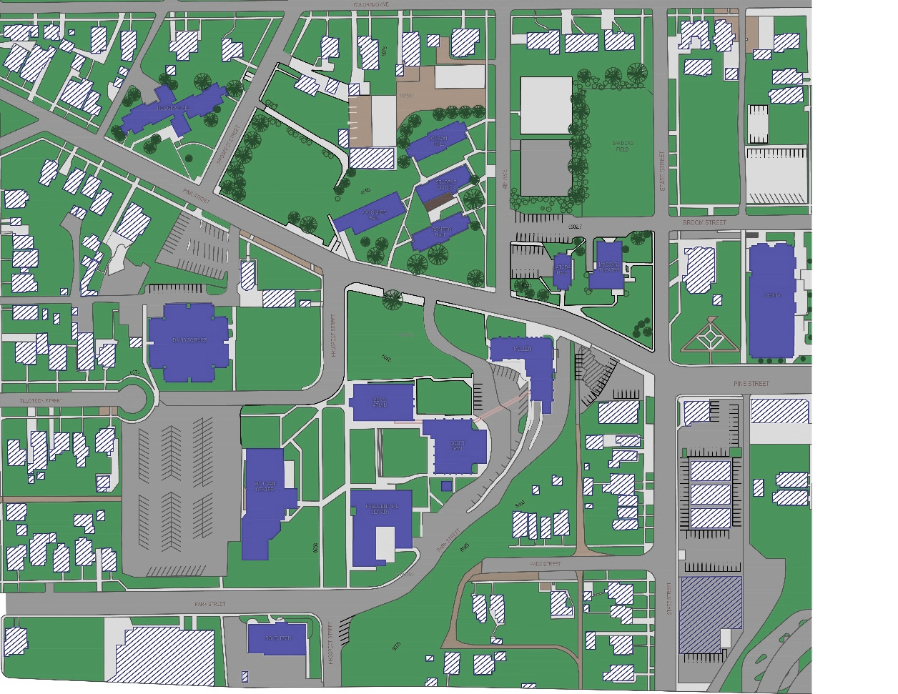
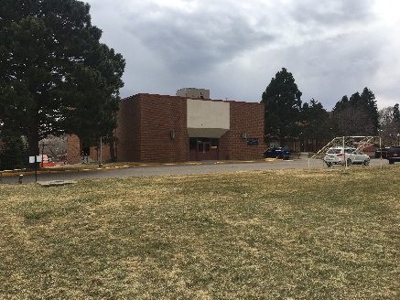
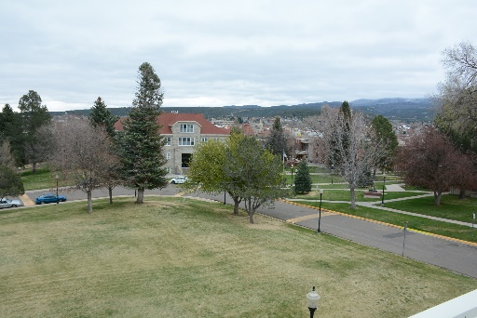
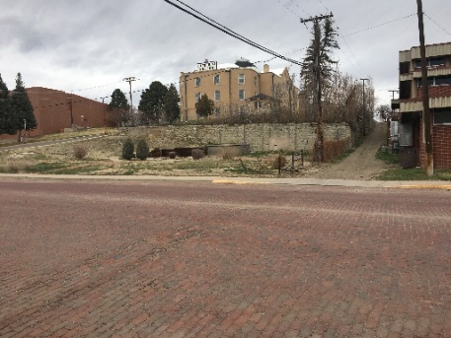
Campus Site Experience Opportunities - Trinidad
What areas can be opportune places to invite people gathering, define the campus center and entry points, showcase a vibrant campus experience?

Slide 8
Facilities Master Plan Four Guiding Principles
FMP Principle One
Establish a strong welcoming campus identity through wayfinding signage and other strategically-placed site amenities. Showcase a vibrant campus experience.
FMP Principle Two
Create a campus hub that is student-centric, with physical building connections that let students gather to see and be seen.
FMP Principle Three
Provide much-needed exterior and interior upgrade improvements to the campus buildings and grounds to support the student life experience for resident and commuter students and academic goals, and faculty and staff experiences.
FMP Principle Four
Designate an area on campus dedicated to the arts and culture.

Slide 10
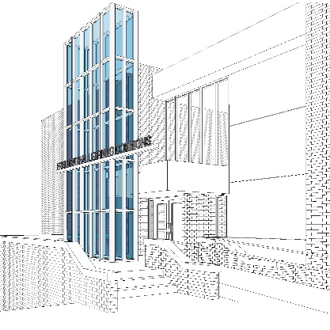
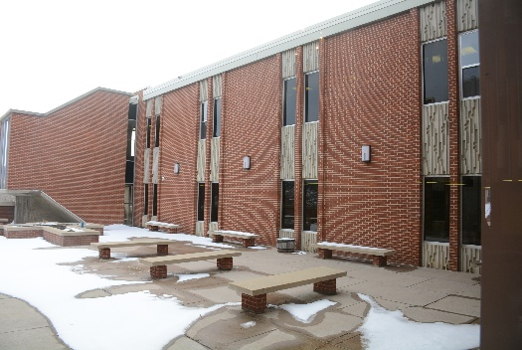
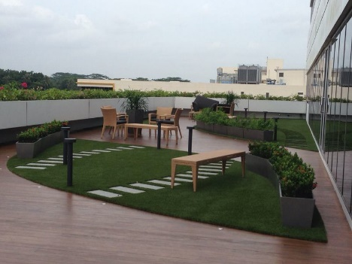
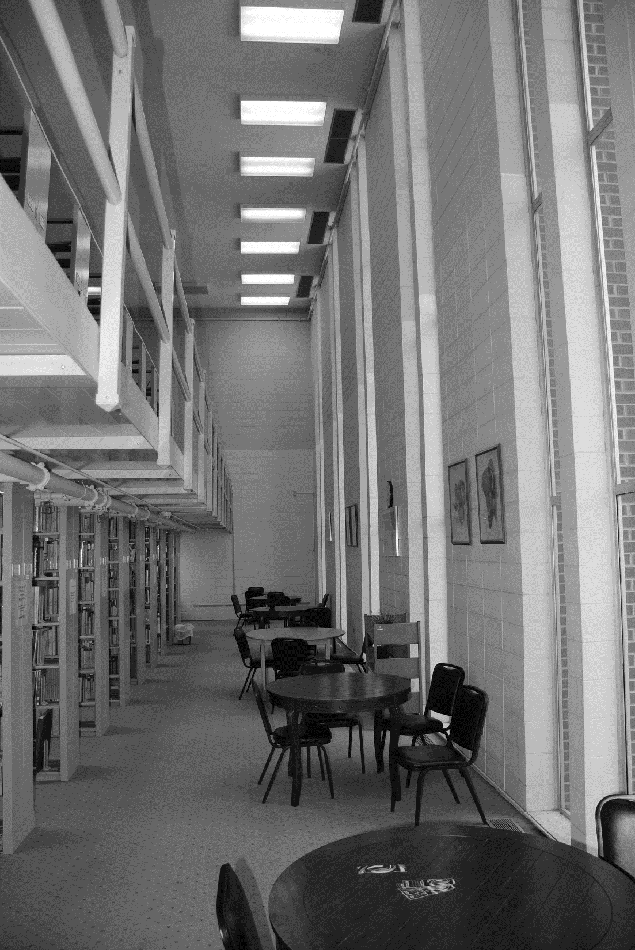
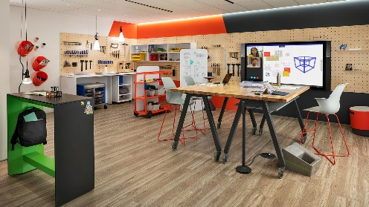
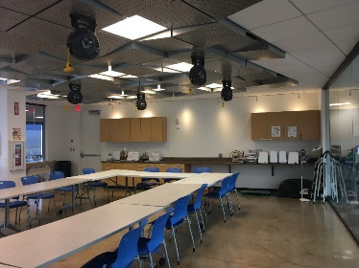
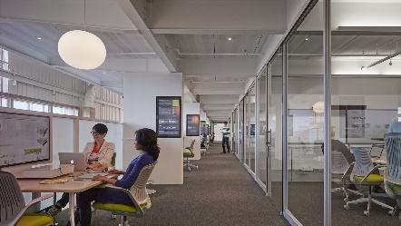
FMP Project 1: 20,195 ASF renovations, all levels Freudenthal Library Renovation Ph. 1 & 2
Open up existing courtyard for
“outdoor room”, informal study,
lounge, exhibits, with sections
of artificial turf.
Highlight Library entrance with
new glass and steel façade,
metal signage, open up vestibule
Create revolving
museum displays
in the Main Level
of the Library
Example of glass enclosed rooms adjacent to open
work areas
Examples of Makerspace Rooms
Learning Resource Center Collaboration
Classrooms Offices Exhibits Meetings

Slide 11
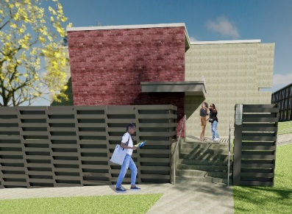
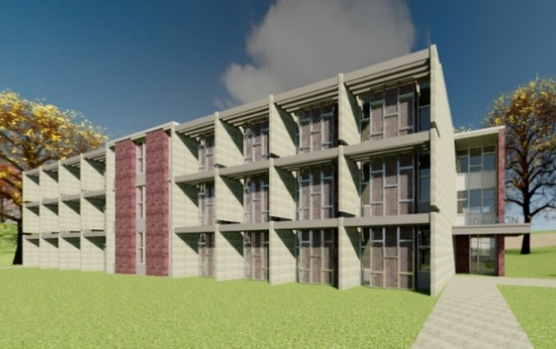
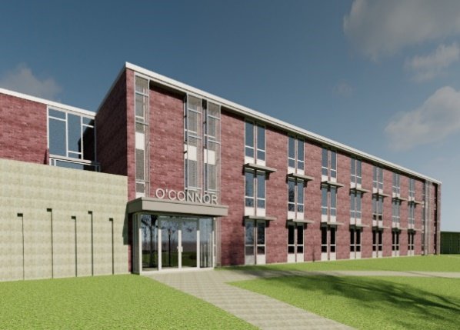
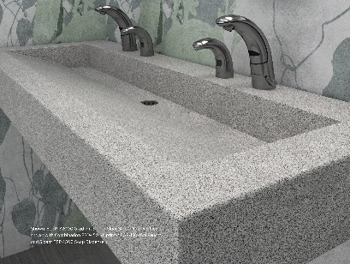
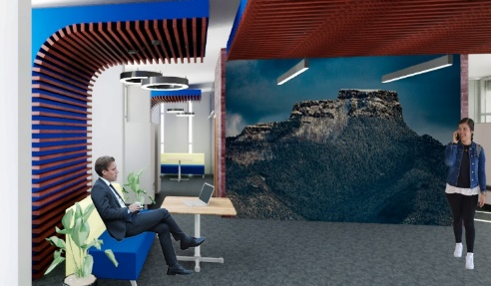
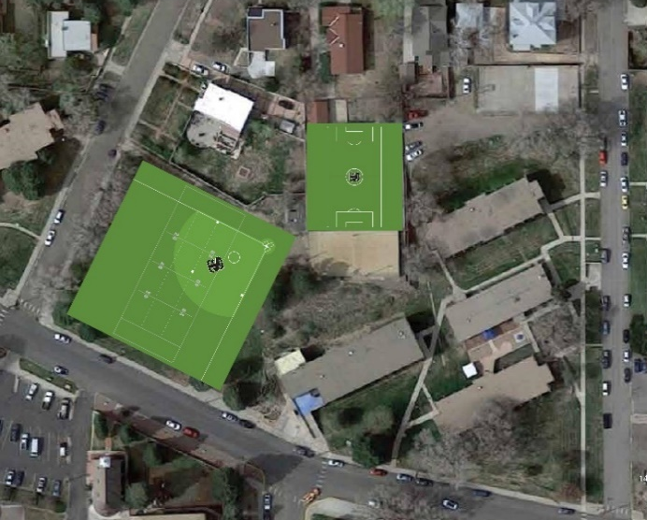
FMP Project 2: Major infrastructure upgrades to improve indoor air quality - heating and cooling, modernization & aesthetic improvements Residence Hall Complex Improvements
L to R: Romero east entrance/modern screen; Johnson south elevation; O’Connor new south-facing entry
Reconfigure layout of centralized
restrooms, new plumbing fixtures,
new finishes
Update finishes, new
Fishers Peak mural at
the Student Center
Study lounge
Convert existing
Tennis court into
Futsal field.
Level existing grass field to be usable athletic and
recreation field
Residence Life Recreation and Athletics

Slide 12
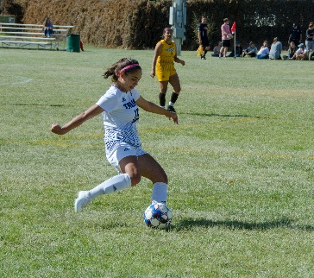
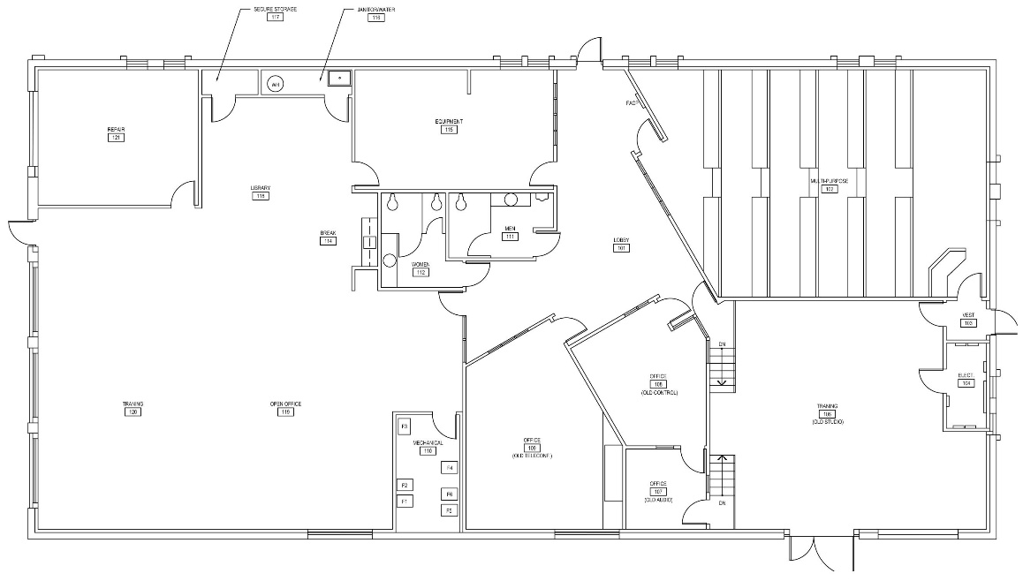
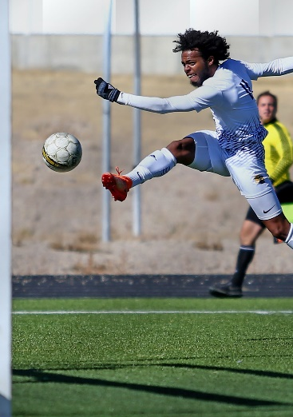
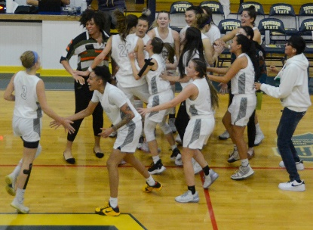
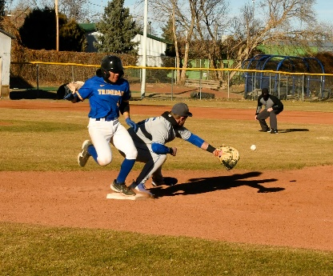
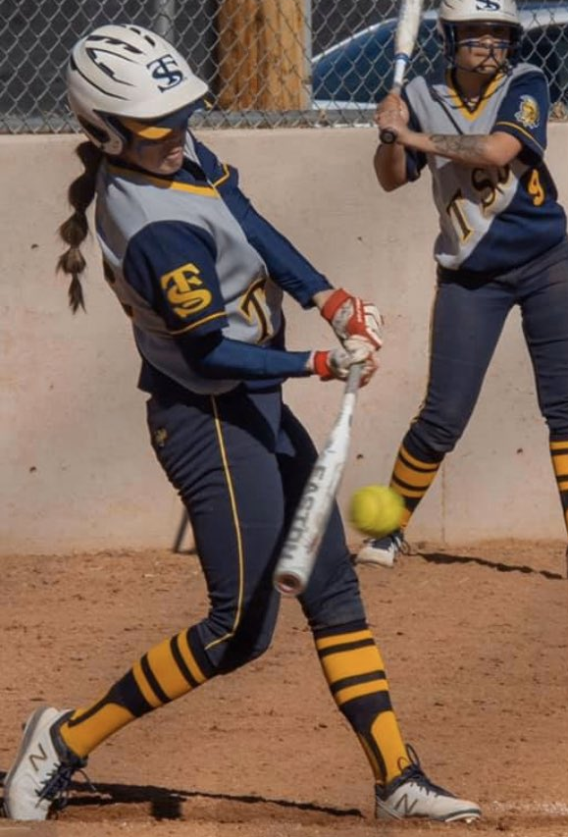
FMP Project 3: 6,000 ASF Boyd Athletic Indoor Practice Facility
Create
office space
New indoor Practice Facility
for TSC Athletics Program,
approximately 6,000 ASF
Evaluate location of
existing electrical equipment
Recreation and Athletics

Slide 13
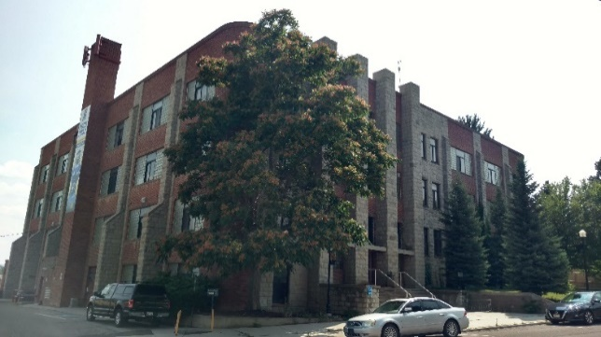
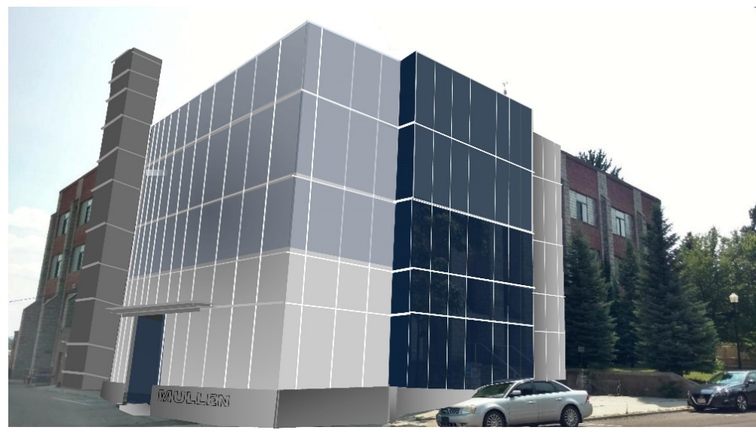
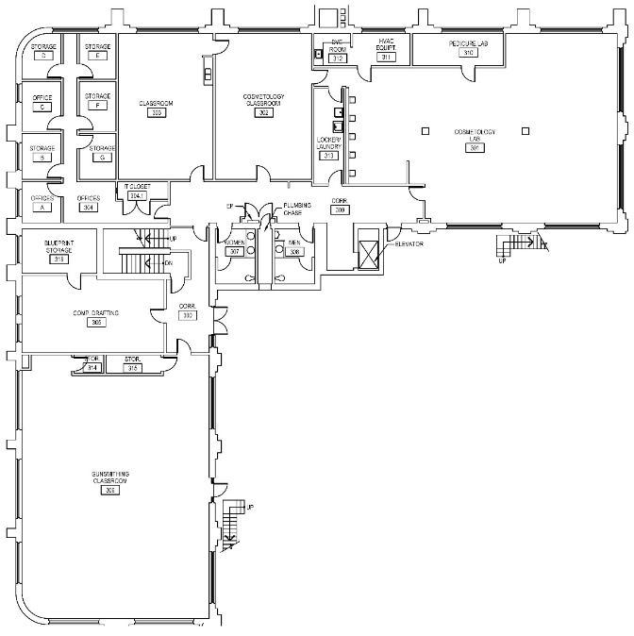
FMP Project 4: Mullen Building Ph. 1 & 2 Façade Treatment/Signage, Addition
Modernize east and north Mullen Building facades with metal and glass cladding over existing brick, windows and stack feature, replace original glass block with new energy efficient windows. Add modern monument sign at this corner to transform the campus entrance at Pine Street / Park Street. Coordinate with Massari Building.
Cosmetology Classroom reassigned to Gunsmithing
Gunsmithing 306 Lab
Addition with
Mezzanine connected
To 4th floor
Teaching Laboratories Classrooms Offices

Slide 14
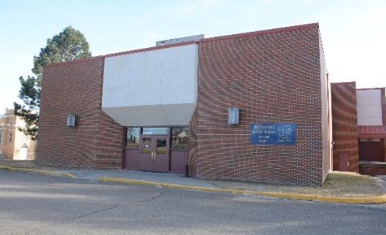
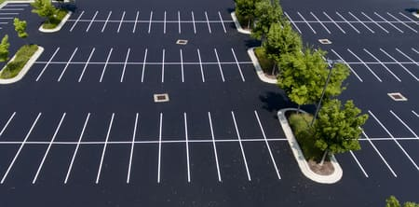
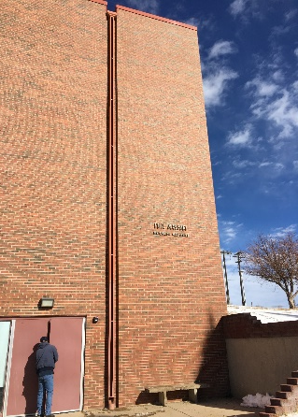
FMP Project 5: Massari Addition Broom Street Plaza, Parking Lot
Develop a plaza space on
Broom Street for art
exhibits, public performances
Expand the Massari
lobby, with new open
glass entrance and store-
front. Add to restrooms,
storage and offices.
Relocate entrance to take advantage
of east-facing natural light.
Propose to convert Sanders Field into 120-count parking lot –
Support performing arts events at Massari, serve as overflow parking for Scott Gym, host food truck events, art fairs
Examples of monument sign, landscape art
Assembly Lecture Classroom Offices

Slide 15
FMP Project 6: Unify Wayfinding, Promote Safety Park Street Crossing Boyd to Sullivan
To new Sullivan Student Center Learning Stairs
Shift pedestrian crosswalk, centered on Boyd Athletic
Practice Facility entrance
Utilize signage, striping, pavement markings to
slow down traffic, alert
Trinidad School District traffic
Prominent dedicated crosswalk

Slide 16
FMP Project 6: Unify Wayfinding, Encourage Movement Sullivan Student Center Learning Stairs
Informal Lounge Informal Learning Space
Informal Meeting Space… See and Be Seen

Slide 17
FMP Project 6: Unify Wayfinding, Promote Safety Zion Lutheran Church Parking Lot Pedestrian Info. Walk
To Pine
Street,
Huggins
Residence
Hall
To Davis Building
Inform pedestrians about the historic legacy

Slide 18
Project 6: Unify Wayfinding Information kiosk, Art Berg Building Signage
Signage art example,
Phil Hardberger Park,
San Antonio, TX
Digital signage example,
CSU Fort Collins, CO
Potential sign at intersection of Pine and Prospect to visually direct to centrally placed kiosk
Highlight the physical center of campus with a modern, visual information signage display that visually connects with points across campus, and compliments the stately Berg Building. Add modern signage to Berg Building entrance.
Inform campus visitors Modern signage

Slide 19
FMP Project 6: Promote Safety Parking Lots Boyd to Sullivan
Fourth Avenue
Convert existing tennis court into dedicated 27-count parking lot for resident students. Plan for lighting and security cameras.
Park /Prospect Streets
Utilize existing open space for approximately
15-count parking lot. Incorporate new lighting.
Create additional parking

Slide 20
FMP Project 6: Unify Wayfinding, Promote Safety Park Street Safety Improvements - East
Utilize signage, striping, pavement markings to slow down traffic, create
sightlines, speed bumps
Two-way
One-way
Safety
interventions
Prominent dedicated crosswalks, signage

Slide 21
FMP Project 7: Sullivan Student Center Ballroom Addition
Create an addition on the west side
of the Sullivan Student Center for a
large assembly area for TSC events and
community events that exceed 250 occupants.
Coordinate the layout of the addition with
current parking layout and truck and bus routes
within the lot.
Residence Life Recreation and Athletics

Slide 22
FMP Project 8: Various Interior Remodels 8.1 Berg 4th Floor 8.2 Berg Room 303
8.1
Move theater props &
costumes out of Berg,
Into Massari
8.2
Convert Office 303 into
Conference Room
Residence Life Recreation and Athletics

Slide 23
FMP Project 8: Various Interior Remodels 8.3 Davis Lower Level - New study areas
Example of seating alcoves
Study Lounges Offices

Slide 24
FMP Project 8: Various Interior Remodels 8.4 Davis Upper Level – Refresh finishes
Example of color, reflective surfaces, glass film, texture
impacting depth of space,
building experience
Example of purposeful
signage, modern fonts
Teaching Laboratories Classrooms

Slide 25
FMP Project 8: Various Interior Remodels 8.5 Scott Gym Storage 8.6 Relocate SGA Offices
8.5
Potentially enlarge Scott Gym level east landing for storage
8.6
Relocate SGA Offices to original more visually accessible location
Example of visible SGA offices, graphics
Recreation and Athletics Offices

Slide 26
Thank you from your Facilities Master Plan team:
Angeline Aradanas-Hall Stephen Hall
Principal Planner Lead Auditor
Steve Schonberger
Planning Specialist

