Slide 1
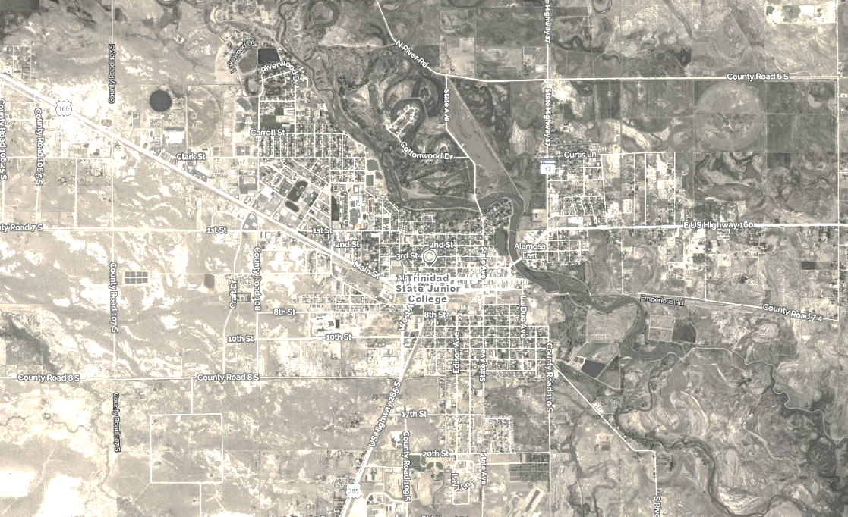
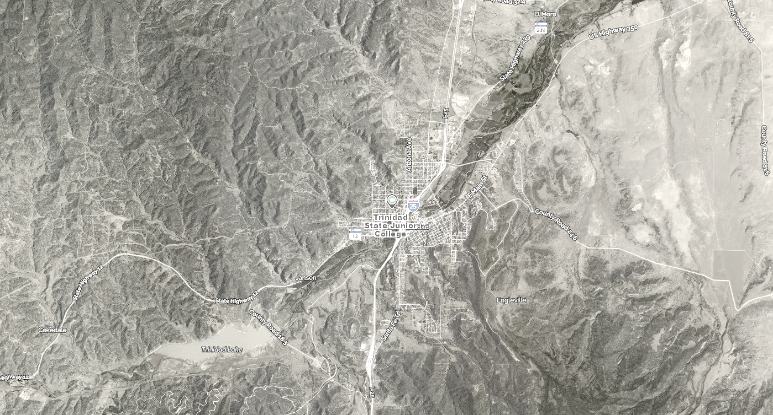

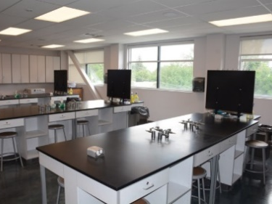
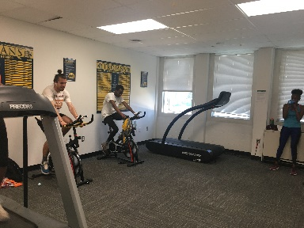
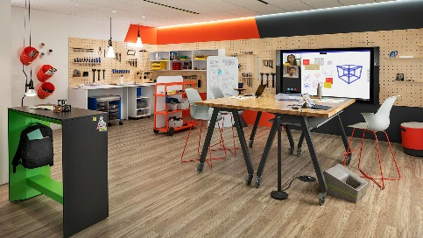
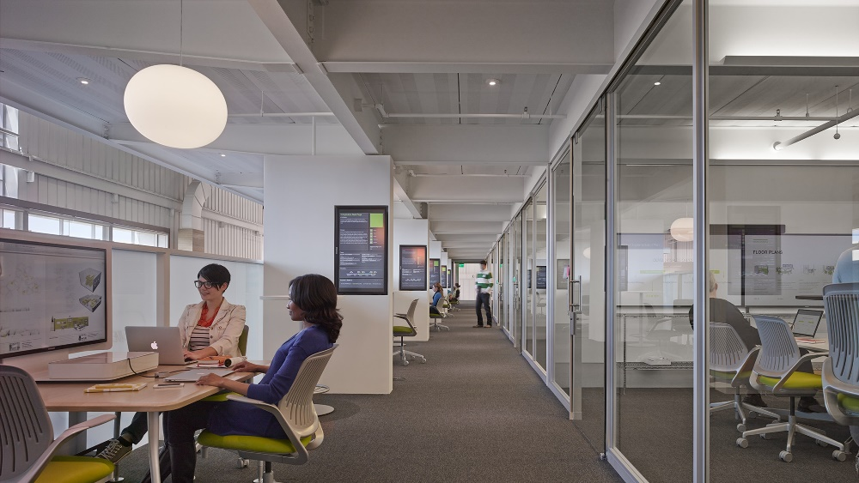
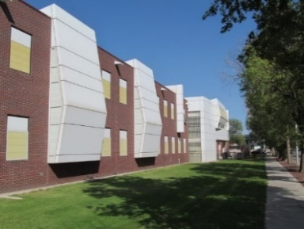
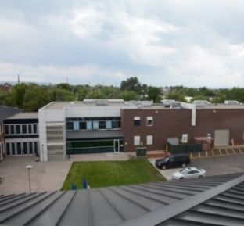
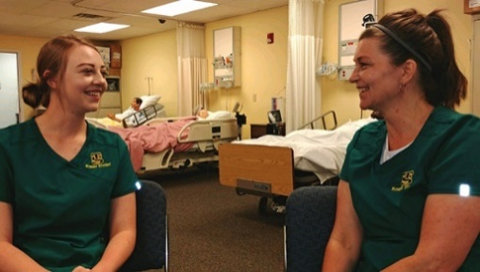


Valley
Campus
Trinidad
Campus
FACILITIES MASTER PLAN – VALLEY CAMPUS
Community Meeting December 6, 2021
Offices
Teaching Laboratories
Recreation & Athletics
Assembly & Exhibit
Learning Center
Classrooms
Informal Learning Space
Other Department Space
Physical Plant

Slide 2
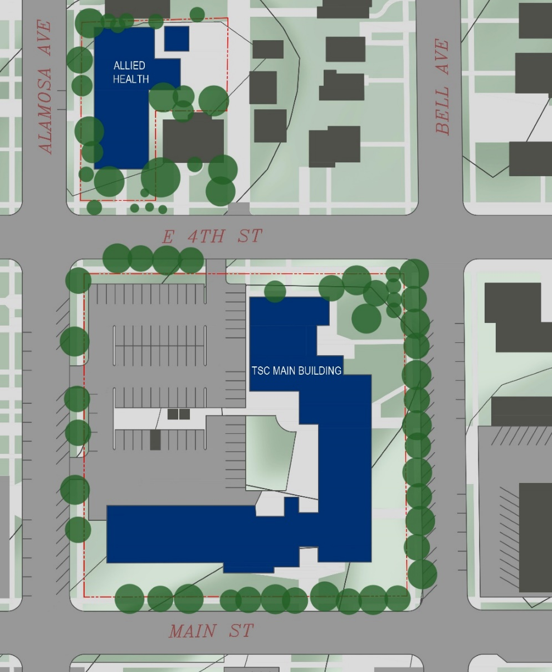
TSC FMP
Committee Members
FMP Team
Dr. Rhonda Epper
Lynette Bates
Kerry Gabrielson
James Kynor
Shannon Shiveley
Al Malespini /
Danny Rogers
Ira Williamson
Michael Salbato
Toni DeAngelis
Jay Jacobson
Hall Architects:
Angeline Aradanas-Hall
Stephen Hall
Nov ‘20
May ‘18
SmithGroup:
Steve Schonberger
Collaboration

Slide 3
Review: The FMP and The Process
A. Purpose of the Facilities Master Plan:
Provides Trinidad State College a comprehensive, active “living” document
to guide the planning of campus facilities
Driven by the TSC Mission, Vision and Values statements and
aligns with TSC Strategic Plan – 2020-2025 Centennial Goals, Academic Plan,
IT Master Plan and physical goals
Flexible and responsive
Participatory
Phased and implementable - manages development opportunities
Main Goal: Facilities Master Plan Ten Year Horizon - 2032
How do we accomplish this goal?
Partnership of TSC community + Hall Architects / SmithGroup
B. The FMP has four parts: (1) Process + Overview
(2) Program Information + Institutional Data
(3) Existing Conditions Assessment
(4) The Plan

Slide 4
FMP + Facility Audit Schedule
Continue meetings, prepare FMP Final Draft for TSC Leadership Team review, confirm FMP projects, refine Draft
Project Kickoff
Participant scheduling, initial data collection: identify academic programs, staffing, resident programs
Confirm enrollment, priority of FMP projects, review data analysis, continue meetings
Final deliverables to TSC for presentation to the State
Two campus sites: Conduct meetings, interviews, prepare surveys, facility inventory data collection, initiate analyses
Nov ‘20
May ‘18
Feb ‘21
July ‘21
Jan ‘22
Dec ‘20
Dec ‘21
Facility Audit documentation
Prepare Facility Audit draft

Slide 5
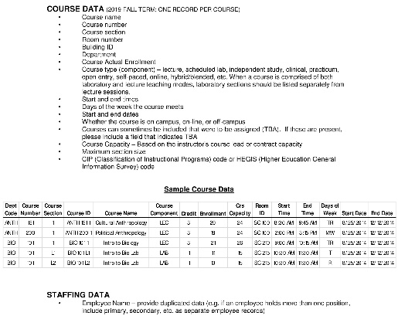
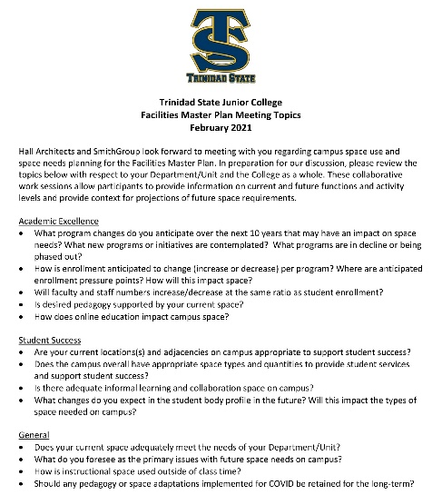
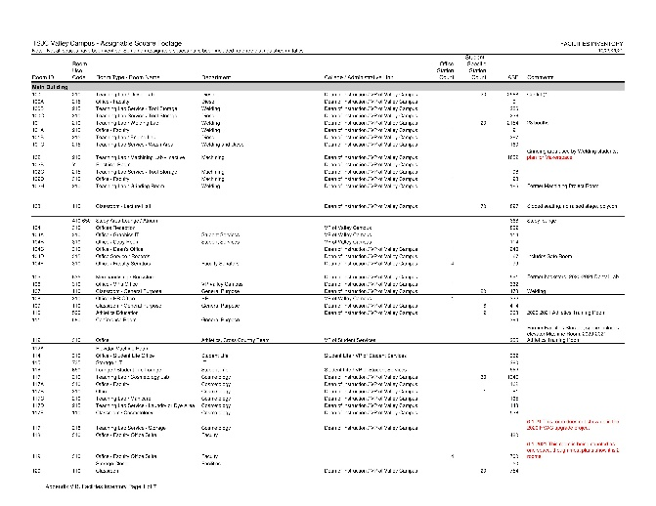
Baseline Data
Collection – Fall 2019
Space Needs Analysis
Base Year Enrollment for Total Campus: (3,946 ASF) deficit
Target Year 2032 Enrollment for Total Campus: (32,327 ASF) def.
TSC Interviews
30+ Interviews
Should any pedagogy of space adaptations implemented for COVID be retained for the long term?
TSC Stakeholder
Interviews – partial list
City of Alamosa, CDOT, Colorado Parks and Wildlife,
Alamosa Convention and Visitors Bureau, Alamosa County Chamber of Commerce
Facilities Inventories / Facility Audits
Two major buildings on the Valley Campus, 58,704 GSF
Both buildings are over 50 years.
Student, Faculty, Staff Surveys
Data Collection

Slide 6
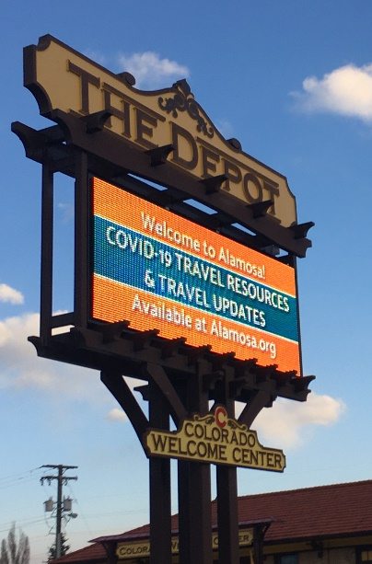
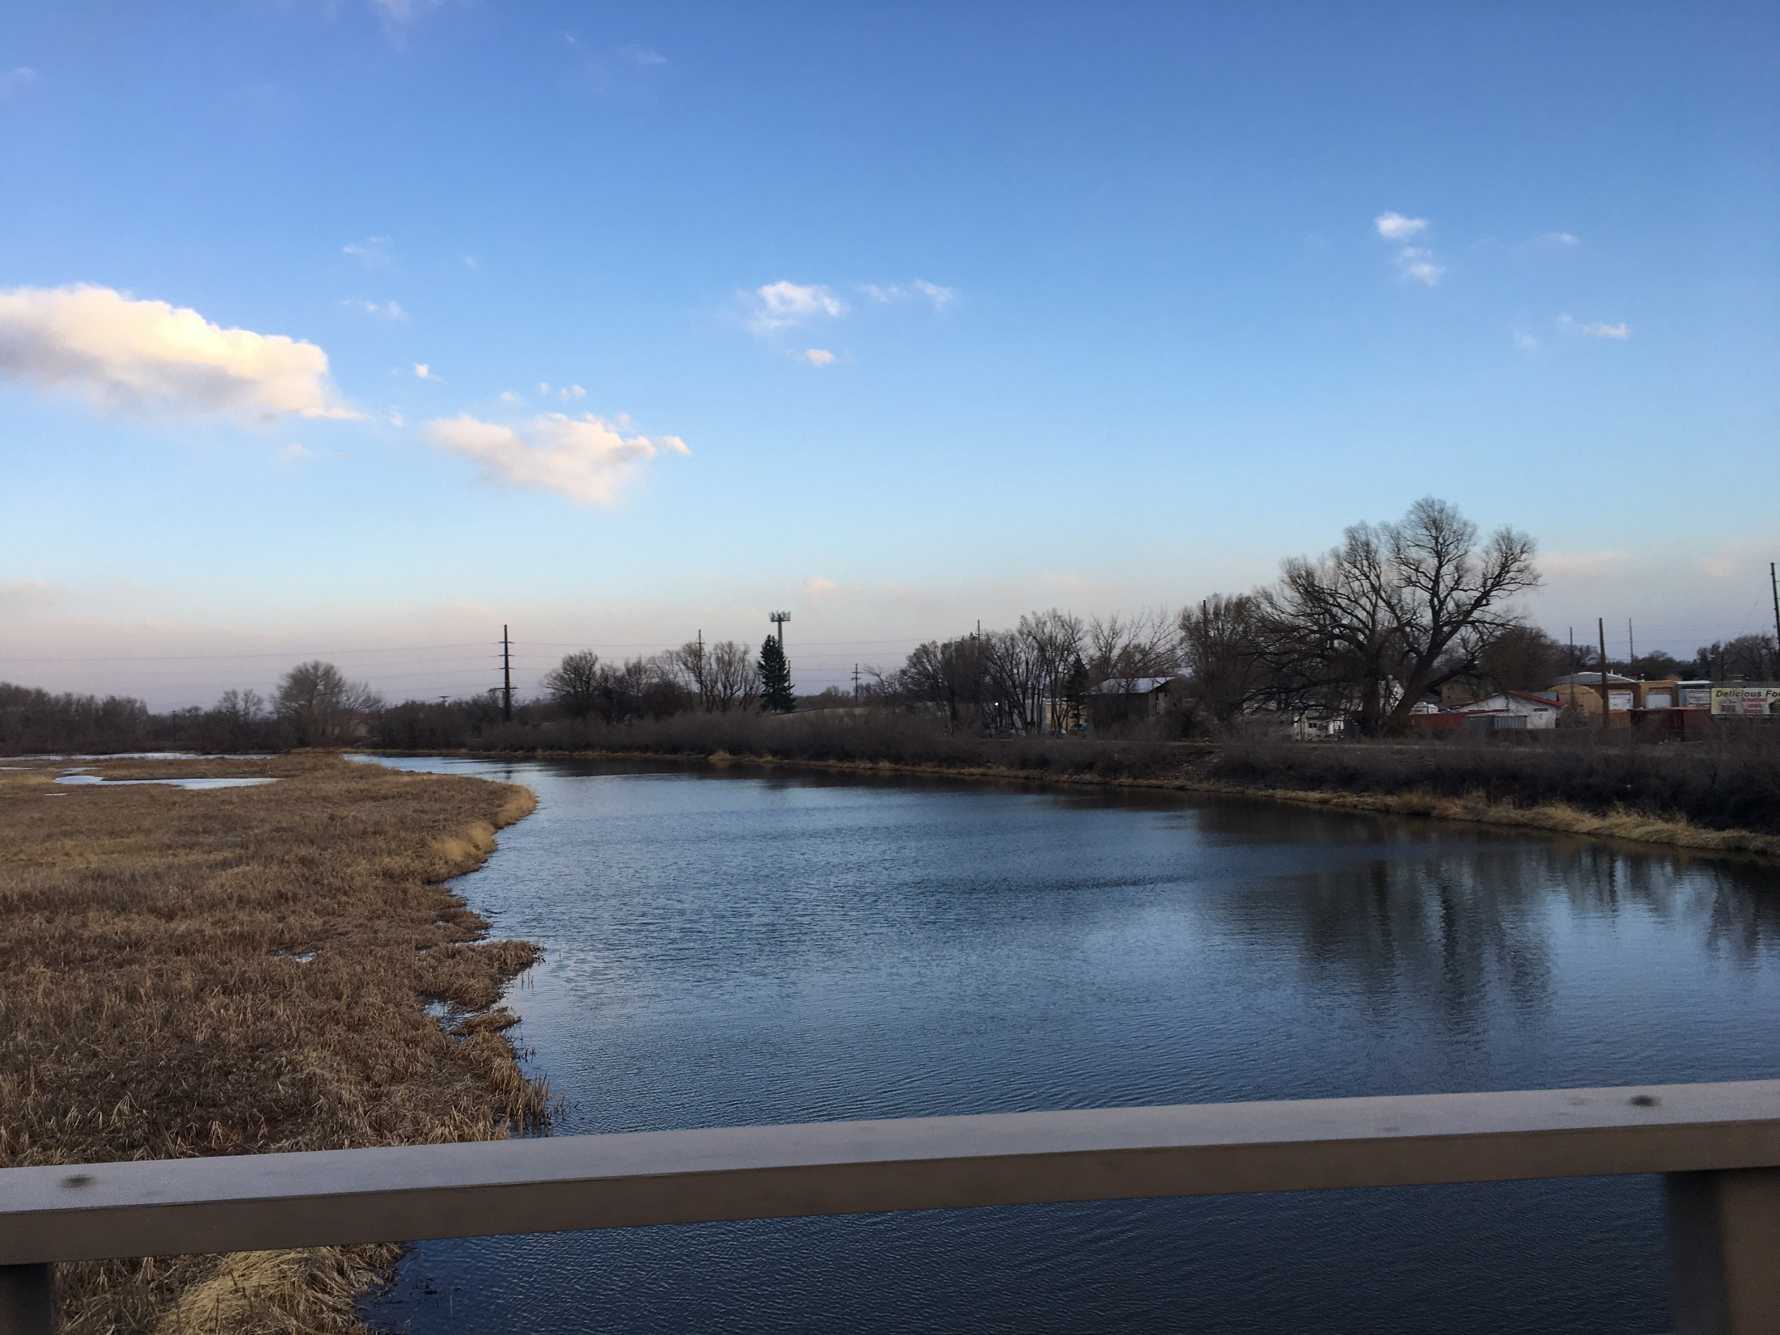
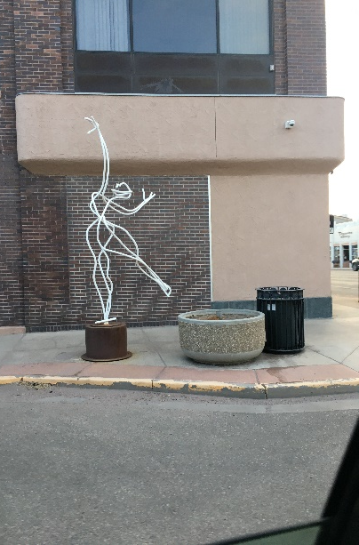

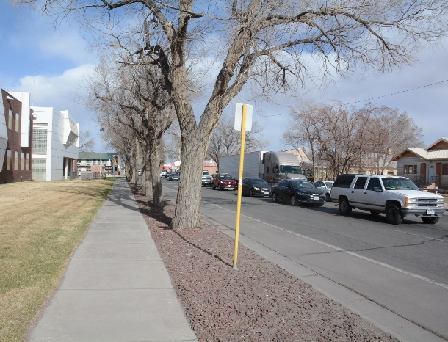
Uniqueness of Place:
Valley Campus, Alamosa

Slide 7
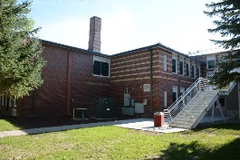
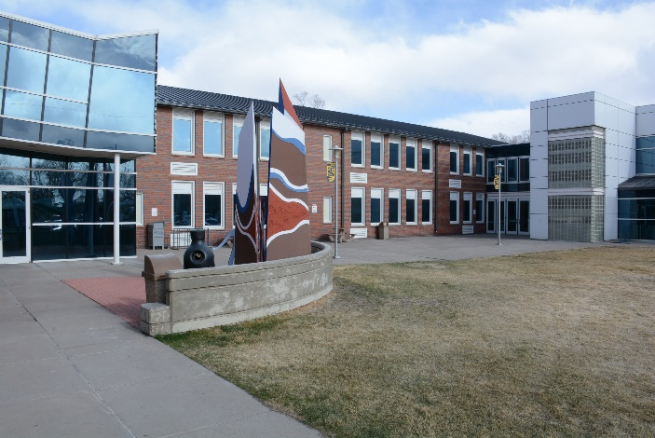
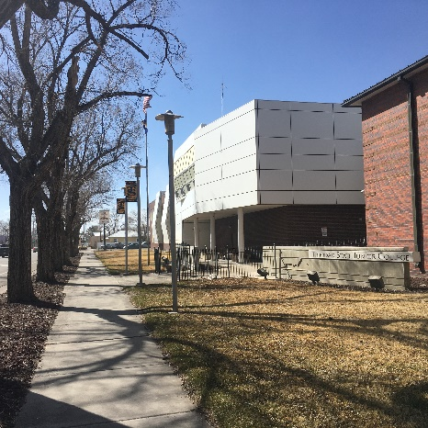
Campus Space
Opportunities – Alamosa
What campus site and building assets can become
opportunities to address space needs issues?

Slide 8

Facilities Master Plan
Four Guiding Principles
FMP Principle One
Establish a strong welcoming campus identity through wayfinding signage and other strategically-placed site amenities. Showcase a vibrant campus experience.
FMP Principle Two
Create a campus hub that is student-centric, with physical building connections that let students gather to see and be seen.
FMP Principle Three
Provide much-needed exterior and interior upgrade improvements to the campus buildings and grounds to support the student life experience for commuter students and academic goals, and faculty and staff experiences.
FMP Principle Four
Create space for community, supporting creatives.

Slide 9
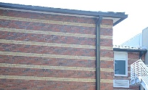
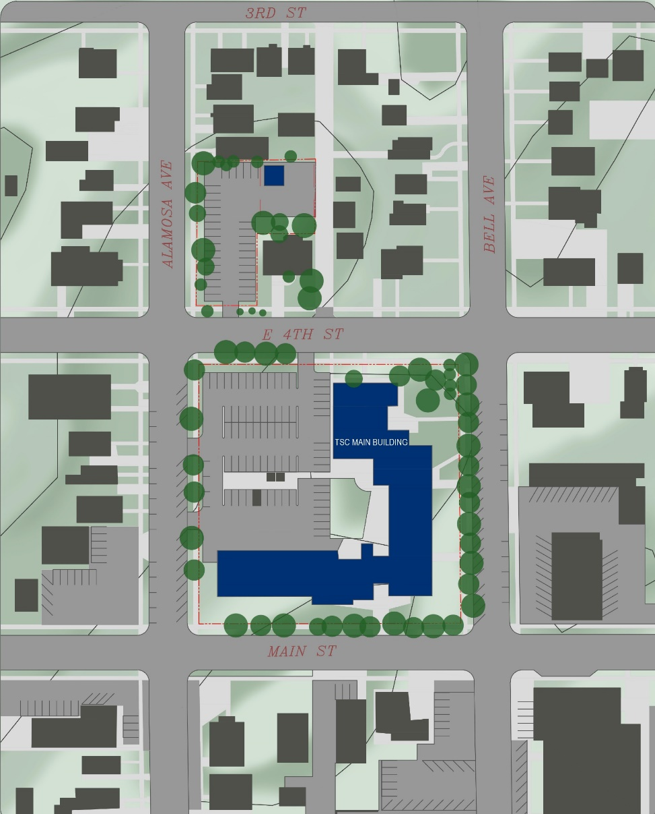
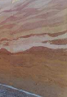
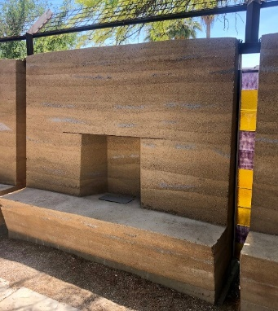
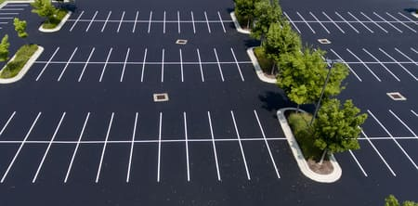
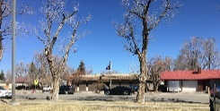
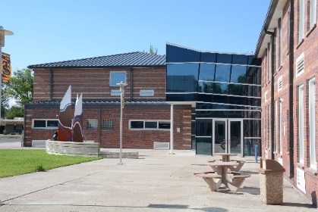
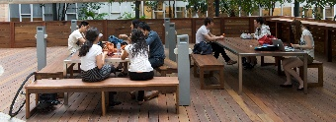
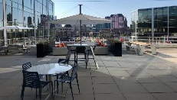
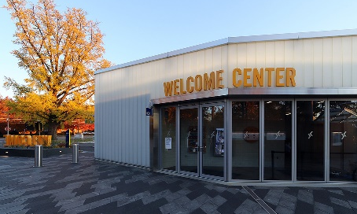

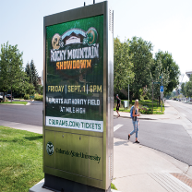
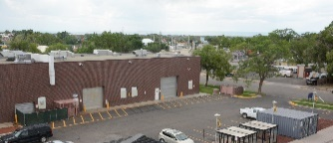



Facilities Master Plan
Valley Campus
Site Development Plan 12/6/2021
PR2: Semi-private courtyards – “outdoor rooms”
Partial height walls to create semi-private and secure courtyards as lounge areas, host outside vendor snack/beverage carts, sheltered from wind, traffic. Rammed earth to complement brick striping, simple modern geometries, built-in seating. Incorporate security cameras, lights. Source: Originate Natural Building
PR3: Demolition of the Allied
Allied Health Building,
create parking lot,
approximately 30 spaces
New parking lot will have lot lighting and be monitored with security cameras.
PR1: New Phase 1A Main Building Addition
for Student Services “One Stop” at
First Floor, Offices at Second Floor
Example of outdoor furnishings.
Source: Steelcase.
This project encompasses a major two-story addition for relocated student services space and creates a Welcome reception counter for the campus. Additional new spaces will include a glass-enclosed study lounge and additional seating areas in the lobby area, along with a student computer lab, a dedicated retail/vending area all on the first floor. NOTE: Size of proposed building addition will need to be evaluated for square footage allowance per code.
Example of main entrance with signage. Architect: Wilkinson Eyre Architects. Source: Bendheim Channel Glass.
NORTH
No scale.
FACILITIES MASTER PLAN PROJECT SUMMARY
TARGET YEAR 2032
PROJECT 1: Phase 1A Main Building Addition
for Student Services “One Stop” at First Floor
Phase 1B Main Building Remodels
Remodel existing classrooms/labs for
Relocated Allied Health programs
PROJECT 2: Site Improvements to increase campus identity and awareness, wayfinding
PROJECT 3: Demolition of the Allied Health Building, create a parking lot
PR2: New TSC Digital Signage for increasing
campus identity, strategically placed
along Main Street
PR1A: Phase 1 Diesel Program relocated off-site, Diesel
Shop to be repurposed for Welding overflow,
Future Construction Trades
Example of digital signage at CSU Fort Collins. Source: University Business.
PR1A: Phase 1 Existing Machining Lab to be repurposed
for a Community Makerspace.
Create after hours entrance from main parking lot for evening activities, access to public restrooms.
Source: Steelcase.

Slide 10
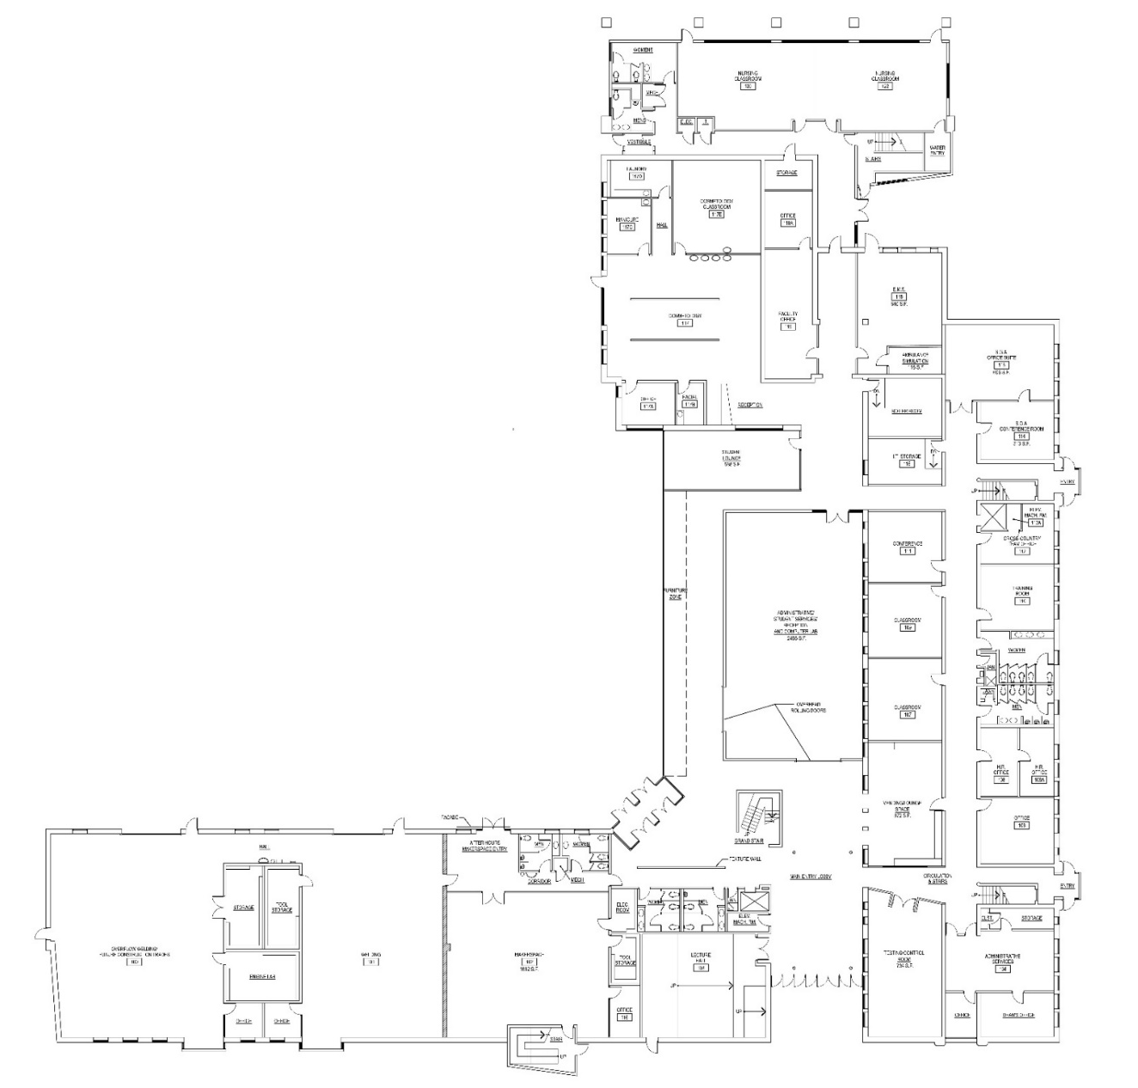
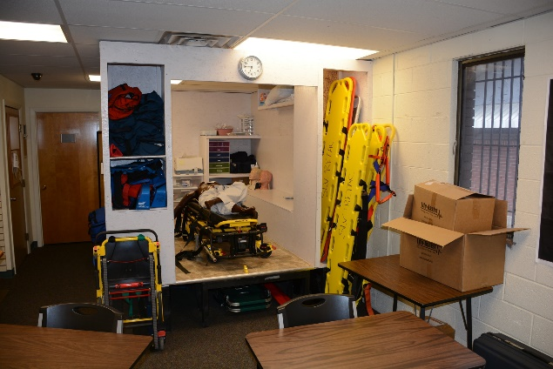


FMP Project 1B: Phase 2
Main Building Addition
Nursing Classrooms, EMT Lab
First Floor
Nursing
Classrooms
assigned to
existing flex
classrooms
EMS Lab
with Ambulance
Sim 756 ASF
New 640 ASF Study Lounge with glass walls
New SGA Office
Suite 640 ASF
New vending
Lounge 672 ASF
New Main Building Entrance
New Testing
Center 734 ASF
Offices Study Lounge Informal study…
to see and be seen

Slide 11
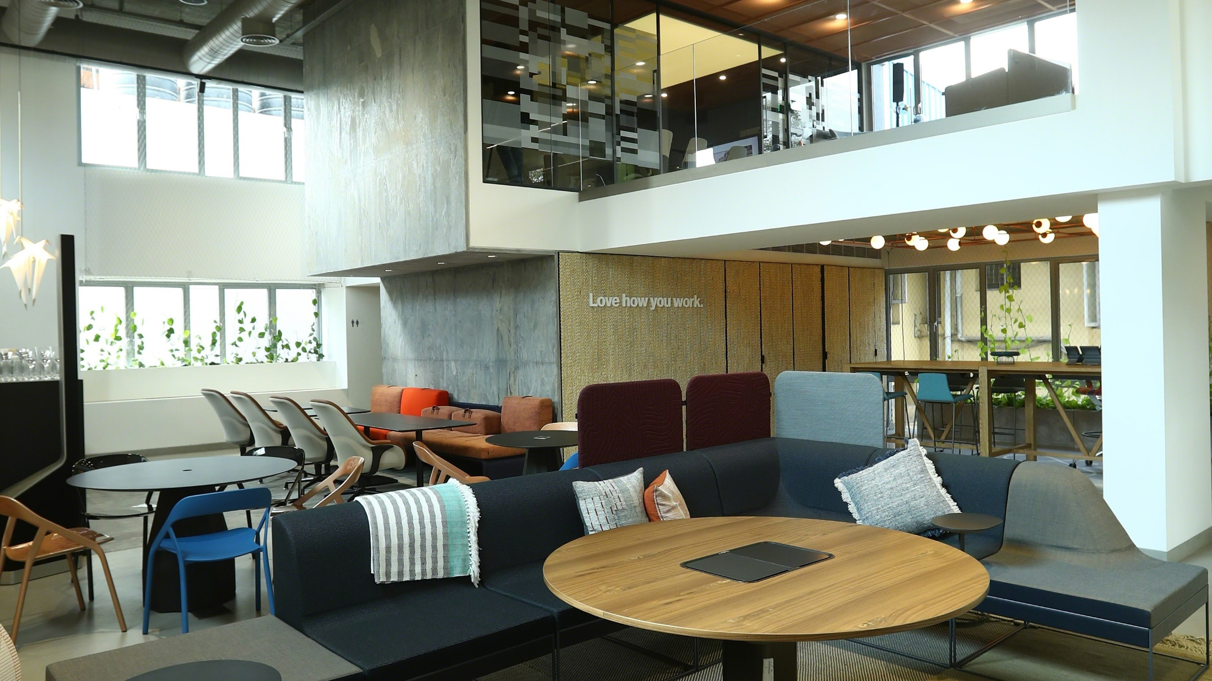
FMP Project 1A: Phase 1
Main Building Addition
“One Stop” Student Services
First Floor
New 640 ASF Study Lounge with glass walls
Dimensioned letter graphics
Area purposed for proposed building addition for TSC student services: Welcome Desk reception counter with roll down grille, student services offices, Computer Lab, 2,486 ASF
New SGA Office
Suite 640 ASF
New vending
Lounge 672 ASF
New Main Building Entrance
New Testing
Center 734 ASF
Example of two story space, has access to natural lighting. Flex furniture lounge. Source: Steelcase.
Offices Study Lounge Informal study…
to see and be seen

Slide 12



FMP Project 1A: Phase 1 South Wing
Reassign Diesel Shop,
Community Makerspace
First Floor
After relocation of
Diesel Program off-campus, reassign space as overflow Welding & Future Construction Trades – Research independent fume exhaust systems.
New public entry lobby for after hours,
new façade, signage
Makerspace example.
Source: Steelcase.
Implement sound barrier, vibration impact mitigation strategies at interiors (walls, ceilings, floors)
New Community Makerspace 1,662 ASF
Collaboration space Teaching Laboratory

Slide 13
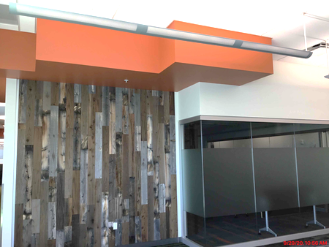
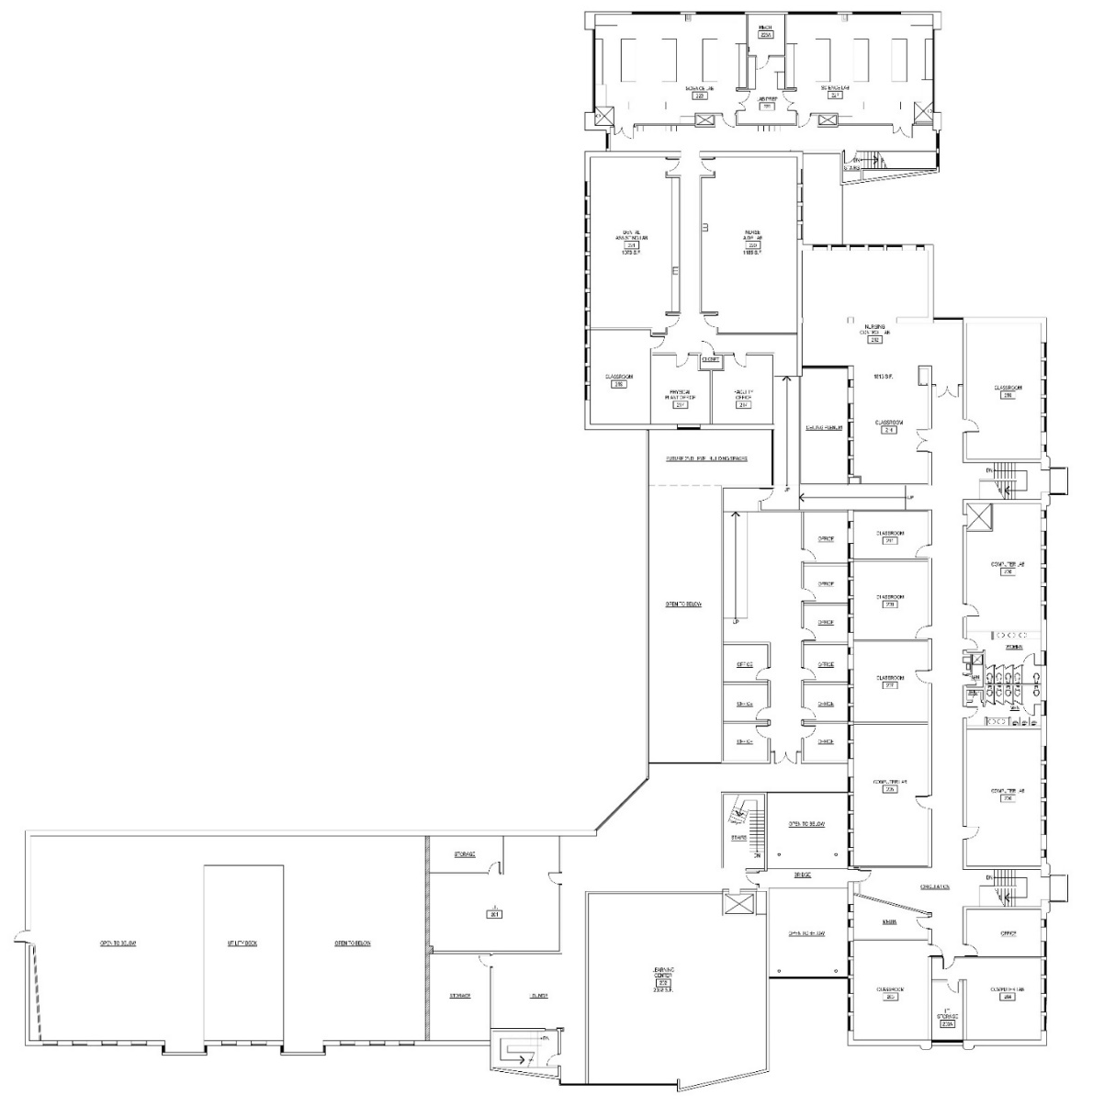
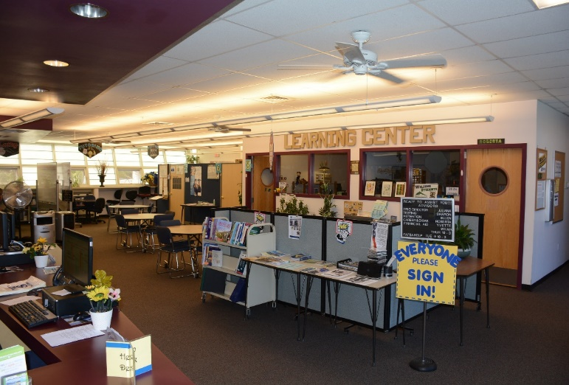
Area purposed for new
office suite – requires ramp access to address level change.
Example of color, reflective surfaces, glass film, texture impacting depth of space, building experience
Area open to first floor below
Repurpose TRiO, Learning Center into new 2,000 ASF approx. assembly area to host large campus events, community events.
Create minimum 1,200 ASF space for esports arena, lounge area in adjacent vacated Testing Center, storage area.
FMP Project 1A: Phase 1
Main Building Addition
Offices, Assembly, eSports Arena, Second Floor
Informal Lounge Assembly

Slide 14
FMP Project 1B: Phase 2
Allied Health Relocation
Nursing Classrooms, EMS Lab
First Floor
Nursing
Classrooms
assigned to
existing flex
classrooms
EMS Lab
with Ambulance
Sim 756 ASF
New 640 ASF Study Lounge with glass walls
New SGA Office
Suite 640 ASF
New vending
Lounge 672 ASF
Existing EMS Lab, Room 10
New Main Building Entrance
New Testing
Center 734 ASF
Offices Study Lounge Informal study…
to see and be seen

Slide 15
FMP Project 1B: Phase 2
Allied Health Relocation
Dental Assisting, Nurse Aide, Nursing Sim Labs - Second Floor
New Nurse
Aide Lab 1,185 ASF
New Dental
Assisting Lab
1,073 ASF
New Nursing
Sim Lab and
Control Room
1,813 ASF
Area assigned to
Future Nursing Lab
Area purposed for new
office suite – requires ramp access to address level change.
Area open to first floor below
Informal Lounge Office

Slide 16


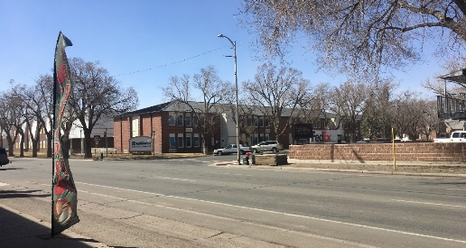
FMP Project 2: Increase campus identity, awareness/security, wayfinding
Site Improvements
Various
Bell Avenue
Example of main entrance with signage. Architect: Wilkinson Eyre Architects. Source: Bendheim Channel Glass.
Partial height, semi-private courtyards, “outdoor rooms” – for informal lounge, informal meetings, study.
New digital signage,
strategically designed and placed to replace existing monument sign. Source:
University Business.
West-bound traffic –
US Highway 160
Source: Originate
Natural Building.
Main Street
Informal Lounge Office

Slide 17
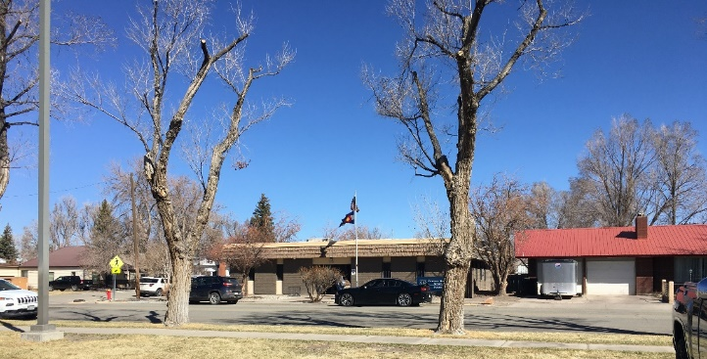
FMP Project 3:
New Parking Lot
Approx. 30 spaces
After the completion of Phase 1B – moving Allied Health programs into the Main Building - demolish Allied Health Building to build new parking lot. Provide lighting and monitor with security
cameras.
Provide additional parking

Slide 18

Thank you from your Facilities Master Plan team:
Angeline Aradanas-Hall Stephen Hall
Principal Planner Lead Auditor
Steve Schonberger
Planning Specialist

