Slide 1
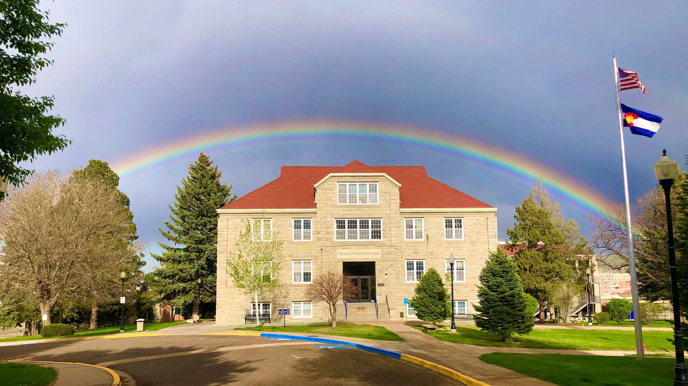
2025-2030
Strategic Plan
Trinidad State College ~ Driving Shared Prosperity

Slide 2
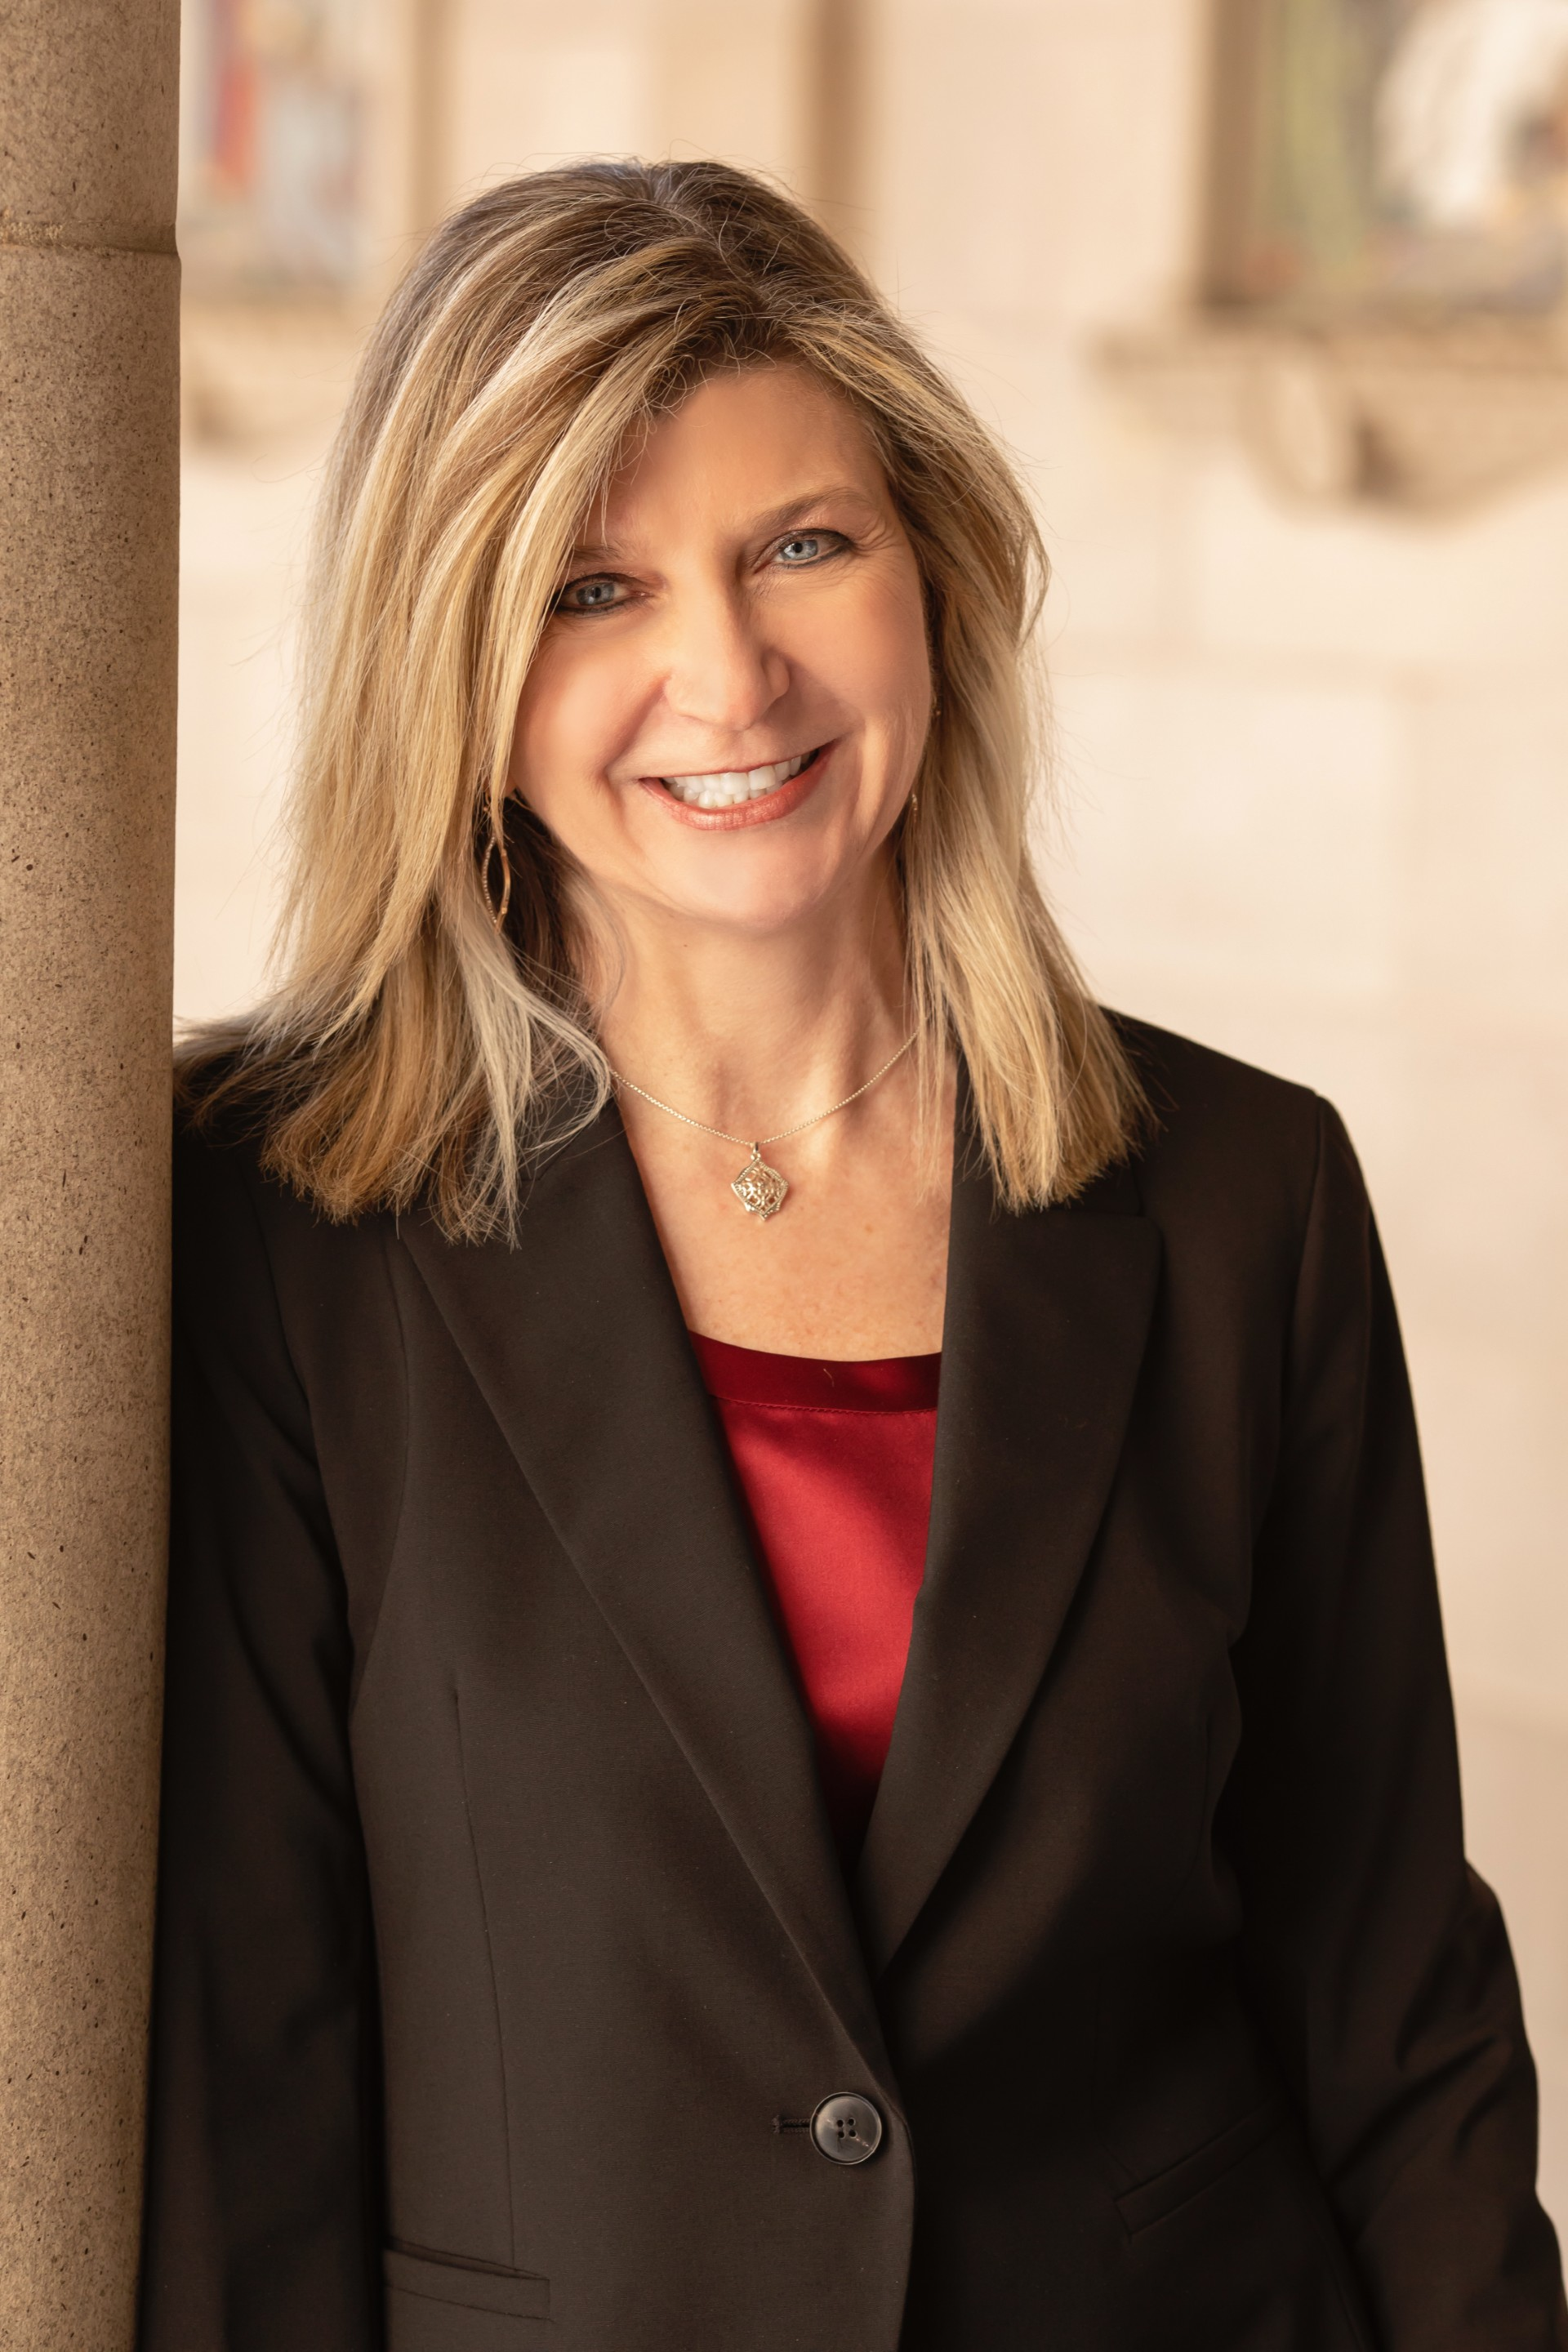
Message from the President
Rhonda M. Epper, Ph.D.
As Trinidad State College celebrates its 100th anniversary, I am pleased to share this 2025-2030 Strategic Plan.
We embark on this next century with a plan that honors our legacy as the first community college in Colorado,
and that looks forward to our vision of shared prosperity in our communities.
This strategic plan sets a direction for the College’s future for the next five years. It serves as a roadmap,
reminding us of our strengths, helping us to align resources with priorities, and guiding our actions and
decisions toward a common vision. It will help us respond to emerging opportunities and adapt to challenges.
The plan was developed with input from our stakeholders. It focuses on our three key constituencies: our
students, our employees, and our community. First and foremost, reflecting our core value of “Students First,”
this plan encompasses and encourages student success. Students are at the heart of our purpose and our
mission. Together with our K-12 and four-year university partners, we prioritize seamless pathways to
academic success. This plan also recognizes that student success is dependent on our faculty and staff, and
it similarly prioritizes employee success and well-being. Without their dedication and expertise, our students
cannot thrive and succeed.
Importantly, this plan acknowledges that we are part of a broader community in Trinidad, Alamosa, and our
entire eight-county service area. We know that our communities create the supportive environment where
Trinidad State College can succeed and which we, in turn, bolster through our academic, cultural, and
economic contributions. While we embrace the traditional community college role of responding to
workforce needs, this plan repositions our College as a driver of workforce and economic development.
In focusing on the above three constituencies and laying out strategic priorities for each, this plan reflects
the College’s vision and mission and aligns with our values.
I hope you’ll join us in meeting the aspirations set forth in this plan

Slide 3
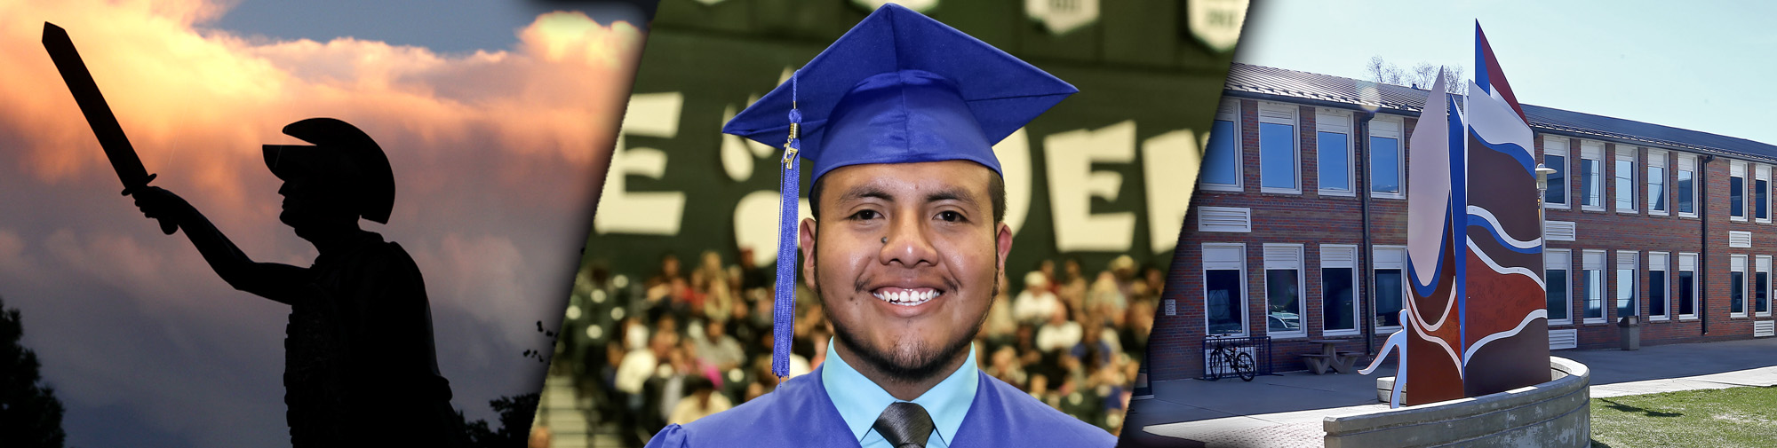
MISSION, VISION, VALUES
Mission: Enrich our diverse communities through quality educational experiences and lifelong learning.
Vision: Driving shared prosperity in our communities.
Core Value: Students First. We put our students at the forefront of everything we do; our primary role is to provide students with the tools they need to be successful.

Slide 4
GUIDING PRINCIPLES
In addition to our core value of Students First, Trinidad State College will pursue the priorities set forth in this Strategic Plan
with the following guiding principles. By upholding these principles, we ensure that our College not only meets its goals,
but also fosters a culture of positive impact.
Accountability with Integrity:
Collegiality and Respect:
We accept our responsibilities, meet our commitments,
and take responsibility for our actions. We are reliable and we instill trust in our actions by prioritizing transparency.
We create an educational environment where all are valued for who they are and what they bring to the organization.
We encourage mutual respect and kindness; we support acceptance of diverse perspectives.
Collaboration:
Inclusion and Belonging:
We listen to each other, recognize each other’s strengths, and work toward our collective goals. We value our relationships with one another.
We prioritize access and belonging in all we do and for all we serve. We avoid isolating ourselves from one another.

Slide 5
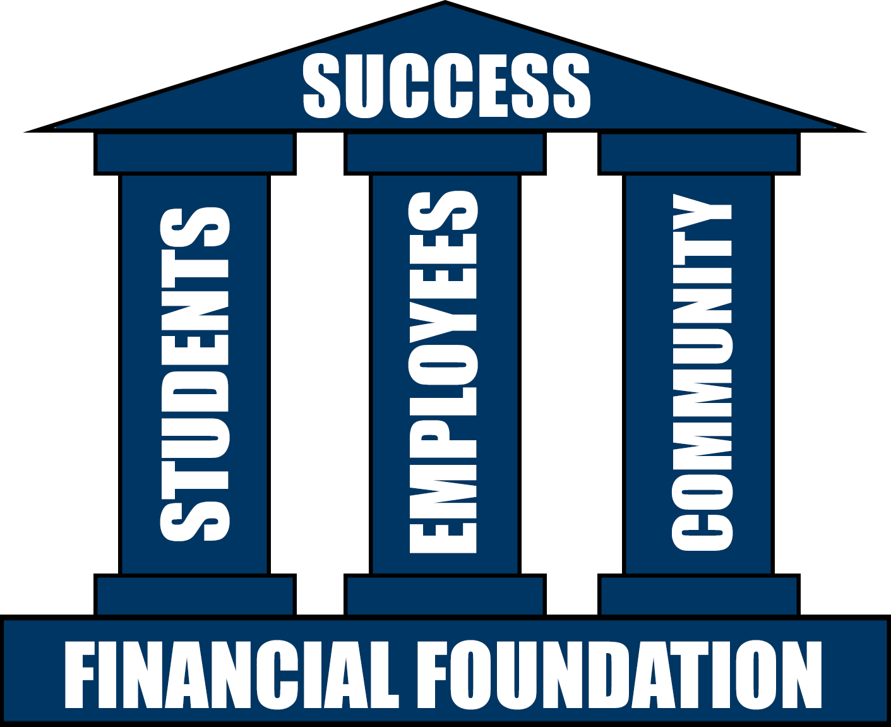
PILLARS OF SUCCESS
In shaping our future, we anchor our Strategic Plan on three
pillars that are fundamental to our existence and our success:
students, employees, and community. By focusing on these
pillars, we strive to create an environment where students thrive,
employees are empowered, and the community prospers.
These three pillars contribute to and require a solid financial
foundation. Trinidad State College will continue focusing on securing
resources that will enable us to enroll and serve more students;
improve our academic offerings to meet transfer opportunities and
workforce needs; and improve our infrastructure and campus facilities.

Slide 6
PILLAR ONE:
Student Success
and Economic Mobility
Trinidad State College will enable more students to succeed in their chosen academic and career pathway.
Why this matters:
Providing students with the opportunities and tools that they need to succeed academically and in their chosen career path is at the core of what Trinidad State College does. Through outreach and collaborative engagement with our K-12 and other partners, we highlight the opportunities and benefits of education beyond high school to encourage students to enroll. Once enrolled, we strive to provide every student with a rigorous experience that includes experienced faculty members, educational resources, support services, and career services. And while their academic experience is paramount, we know that student success is enhanced by opportunities for personal growth, including through athletics, student organizations, community service, employment, and through other activities.
Our strategic priorities in this area encompass the key milestones along students’ academic pathways and focus on an environment where all students thrive academically and complete their academic goal, whether that be to transfer, enter the workforce, or obtain a new skill. Our priorities also recognize that while the reasons for seeking—and benefits of obtaining—a postsecondary education are many, the number one reason cited by students is to improve career opportunities and economic mobility. Thus, as we look at outcomes beyond a student’s time at Trinidad State College, our priorities value our relationships with university partners and employers.

Slide 7
PILLAR ONE:
Student Success
and Economic Mobility
Strategic Priorities
Increase enrollment annually:
Increasing enrollment remains both a priority and a challenge in Colorado and nationally. Despite the challenges, we know our economy demands it and the stability of our budget requires it.
  How we will measure success:
  Increase enrollment to 1500 FTE by 2030.
Increase completion:
Earning a credential signifies a level of knowledge and expertise that will open doors to better career opportunities. Conversely, too many of our students do not complete and are thereby left with “some college, no degree,” limiting their future opportunities.
  How we will measure success:
  Increase the graduation rate to 60% by 2030.
Increase successful transfer to four-year institutions:
Surveys suggest that up to 80% of community college students plan to earn a Bachelor’s degree. Transfer to a four-year institution can lead to stronger student outcomes and increased employability.
  How we will measure success:
  Increase the number of successful transfers to 275 by 2030.

Slide 8
PILLAR ONE:
Student Success
and Economic Mobility
Strategic Priorities
Erase equity gaps:
With 30 years designated as a Hispanic Serving Institution, Trinidad State College takes pride in its efforts to improve equitable student outcomes. But with retention, completion, and other measures showing gaps between white students and students of color, work remains to be done.
  How we will measure success:
  Shrink the equity gap to zero
  (retention, graduation, and transfer rates for students of color compared to non-students of color).
Increase return on investment for students:
For students’ investments to pay off, they should be better off financially for having chosen to invest in a higher education credential. Because increased earnings and career advancement can take years to materialize, our focus is on factors that the College can control and assess that contribute to such long-term benefits. Programs of study should lead to a job or career that pays a living wage or a career that is in high demand in the community. Work-based learning opportunities, including internships, clinical rotations, and other interactions with employers can contribute to career success and increase a student’s chances of successfully transitioning into the workplace.
  How we will measure success:
  Increase the percentage of programs and students in programs that are high-demand and/or lead to a living wage.
  How we will measure success:
  Offer at least one work-based learning experience within each program-of-study by 2030.

Slide 9

PILLAR TWO:
Valuing our Employees
Trinidad State College will foster a healthy professional environment to attract and retain the best faculty and staff.
Why this matters:
The College’s success in carrying out its mission depends on faculty and staff.
They are the backbone of the College’s work and provide the essential support
and infrastructure that enable students to thrive. Investing in our faculty and
staff promotes a more motivated, productive, and committed workforce that
directly impacts the quality of education and services provided to students.
Our strategic priorities in this area focus on a professional environment that
attracts and retains high-quality faculty and staff. Trinidad State College
knows that salary and benefits are vitally important to employees. We
further understand that job satisfaction is tied to other factors, including
but not limited to the opportunity to gain new knowledge and skills, the sense
of being valued and appreciated, and the opportunity to innovate and advance
professionally.

Slide 10
PILLAR TWO:
Valuing our Employees
Strategic Priorities
Focus on employee well-being and work-life balance.
Trinidad State College expects the very best from its employees. We know that to give the very best, employees must be healthy and motivated; and we know that giving their best simultaneously requires time and energy to enjoy their personal live.
  How we will measure success:
  Increase retention rate to 90% (excluding retirement) by 2030.
Cultivate leadership and job satisfaction through professional development.
Leadership takes many forms. Trinidad State College seeks to equip its faculty and staff with the most up-to-date skills and knowledge, enabling them to effectively support students, grow in their fields, and contribute to our mission.
  How we will measure success:
  Reach 100% employee participation annually in professional development by 2030.
Increase salaries to make Trinidad State College a competitive employer in Trinidad, Alamosa, and statewide.
Employees are our most important asset. We know that to attract the best workforce to Trinidad State College, our compensation package must be competitive.
  How we will measure success:
  Bring Trinidad State College average salaries within 10% of Denver-Metro college averages by 2030. *
  * Variations occur depending on years of service, degree levels, and other factors. This metric is dependent on fiscal stability through maintaining and increasing
  enrollment.

Slide 11
PILLAR THREE:
Community Prosperity
Trinidad State College will play a catalytic role in the economic development of our communities.
Why this matters:
Trinidad State College is only as healthy and prosperous as the communities in which it lives. We serve Las Animas and Huerfano Counties, as well as Alamosa and the entire San Luis Valley. We are both an economic engine and an intellectual hub for our communities. Our campuses attract talent and promote success among local businesses by fostering entrepreneurship and skill development. Businesses, in turn, offer professional opportunities and pathways for students. Strong partnerships among our campuses and local communities will drive student success, job creation, and economic growth.
Our strategic priorities in this area center on full implementation of Emergent Campus, which includes a state-of-the-art MakerSpace and Business Innovation Training Hub. Emergent Campus aims to create jobs, attract new businesses, and train local students and adults to pursue business and technology-related career opportunities. Our priorities also recognize opportunities to increase engagement with our communities more broadly in all we do, from athletics to community service projects to cultural and social activities.
While our strategic priorities focus on activities and outcomes centered on the College, our intent is broader impact in our communities. We recognize the challenges inherent in attributing direct causality between our actions and these broader economic indicators; we nonetheless will seek and track such metrics as job creation, increases in living wage jobs, and overall economic growth..

Slide 12
PILLAR THREE:
Community Prosperity
Strategic Priorities
Fully implement Emergent Campus:
Emergent Campus envisions a vibrant hub where education, business, and industry intersect to offer myriad opportunities.
It will provide students with internships, certificates, and hands-on learning experiences.
  How we will measure success: Fully meet grant metrics.
Develop partnerships with local businesses and community groups :
Trinidad State College has relationships and structures in place that facilitate community involvement in academic programs. Much more can be done to facilitate more vibrant partnerships that lead to opportunities for students and lead to community prosperity.
  How we will measure success: Increase the number of participants engaged in the College’s outreach programs
  (e.g., Artist lectures, MakerSpace, Non-credit offerings) by 10% annually.
  How we will measure success: Appoint a community engagement committee on each campus. Committees will implement an outreach strategy to communicate the College’s resources, programs, and opportunities by June 2025.
Increase the number of graduates who live and work in our communities:
Trinidad State College graduates who remain in the region contribute to economic vitality. Their continued presence can build stronger ties between the College and the surrounding region.
  How we will measure success: Identify and implement approaches to gather data on students who remain and work in the region.

Slide 13

CONTACT TRINIDAD STATE
TRINIDAD STATE COLLEGE ~ Trinidad Campus
600 Prospect Street
Trinidad, CO 81082
TRINIDAD STATE COLLEGE ~ Valley Campus
1011 Main Street
Alamosa, CO 81101
Phone & Web
TEL: 1-888-TSC-1925
WWW: trinidadstate.edu

